Slide 1
Week 7: The Business Cycle
Kurlat Chapter 12 and 13

Slide 2
Announcements
Discussion Week 7 is available
Problem Set 3 due Friday 1/24
Presentation Group 2 is tonight
Presentation Set 3 on Tuesday 1/28
Send slides by 1/25

Slide 3
Overview
Business Cycles
What is a business cycle and how is it determined?
Patterns in Business Cycles
Post-World War II Business Cycles
The Phillips Curve
The Real Business Cycle Model (Neoclassical Model – Medium Run)
A Two-Period Model
Markets
Productivity Shocks
Other Shocks
Assessing the Real Business Cycle Model

Slide 4
Business Cycles
Kurlat Chapter 12

Slide 5
What are Business Cycles?
The traditional definition of a business cycle (Burns & Mitchell, 1946)
“Business cycles are a type of fluctuation found in the aggregate economic activity of nations that organize their work mainly in business enterprises: a cycle consists of expansions occurring at about the same time in many economic activities, followed by similarly general recessions, contractions, and revivals, which merge into the expansion phase of the next cycle.”

Slide 6
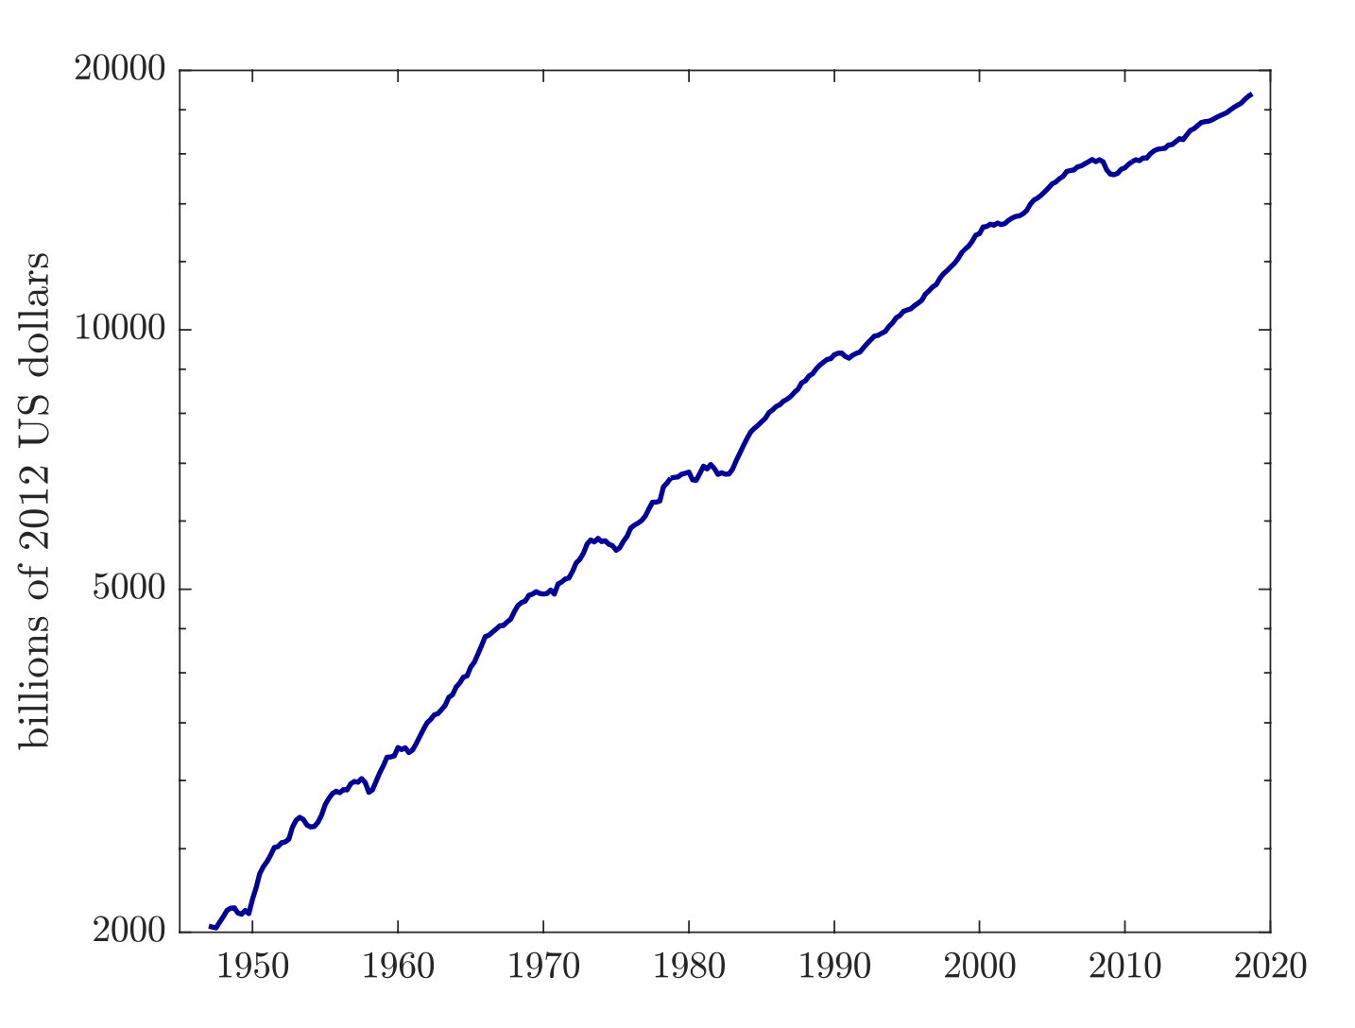
What are Business Cycles
The evolution of US GDP since 1947
The business cycles “wiggles” around a general upwards trend or trajectory in GDP
The evolution of GDP is irregular, where GDP may grow steady for a long time, or it may expand rapidly and contract steeply

Slide 7
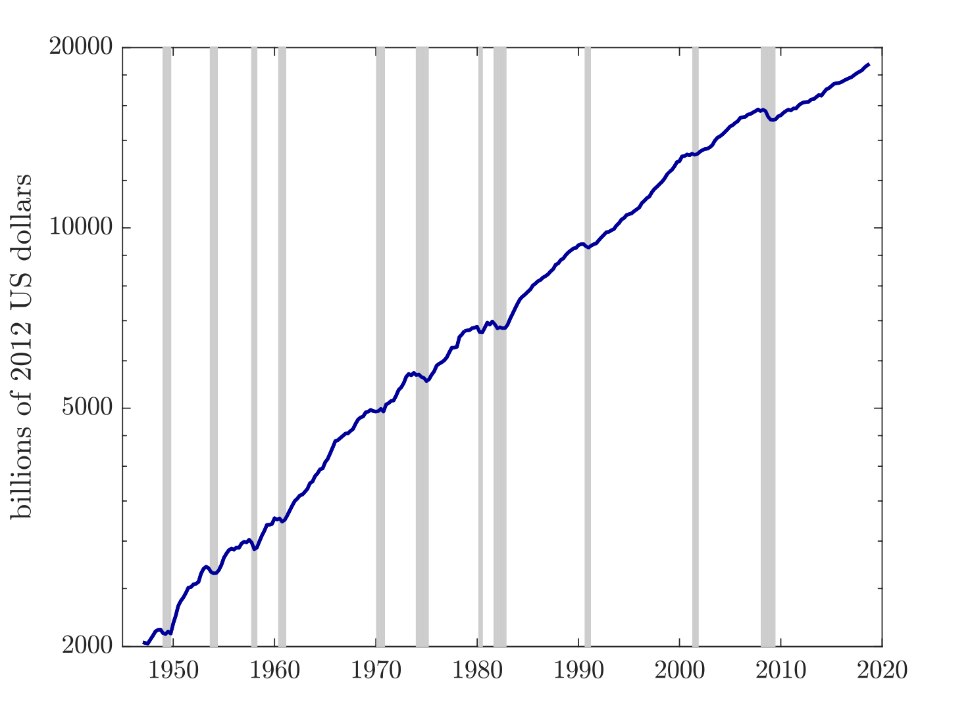
What are Business Cycles
Expansions are periods when GDP is growing
Recessions are periods when GDP is contracting
Recessions are sometimes considered two consecutive quarters of GDP contraction, but not always

Slide 8
How is the business cycle determined?
Recessions are determined by a committee within the National Bureau of Economic Research (NBER)
These are the gray areas
The beginning of a recession starts at the ”peak” or end of an expansion period when GDP begins declining
The end of a recession starts at the “trough” or beginning of a new expansion period when GDP grows again

Slide 9
How is the business cycle determined?
The committee does look at GDP growth, but they also consider a broad range of indicators
With advanced estimates from BEA, there was a 2.0% decline in Q1 2022 and a 0.6% decline in Q2 2022, but this was not declared a recession.
Why?
Robust labor market, positive industrial production, and advanced estimates were revised
Q1 2022 was 1.0% decline and Q2 2022 was a 0.3% increase
https://www.dallasfed.org/research/economics/2022/0802

Slide 10
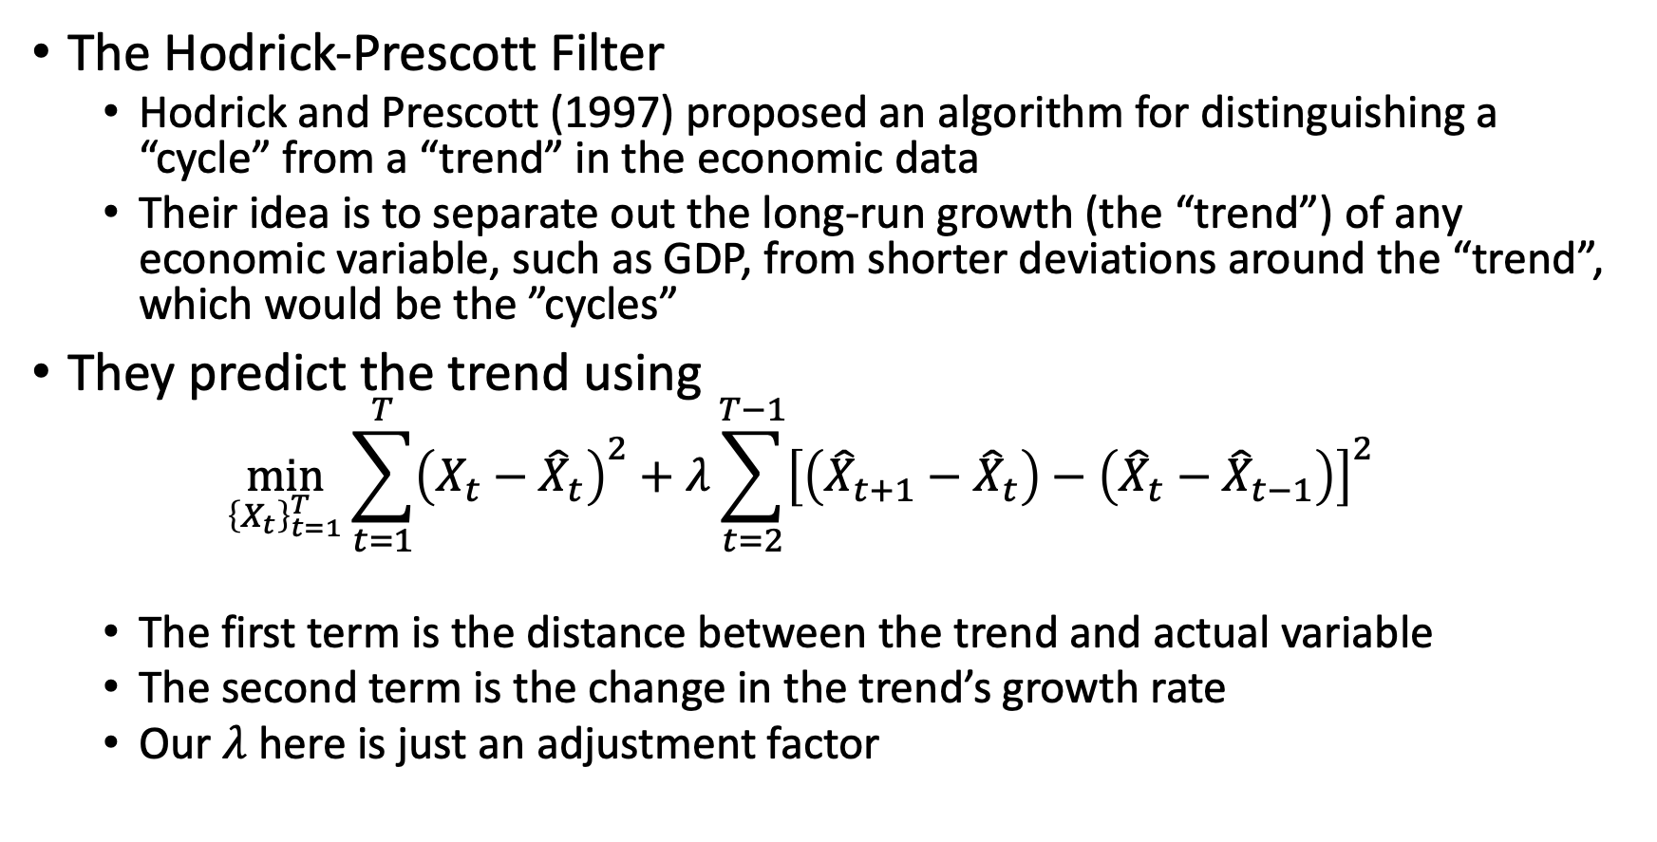
How is the business cycle determined?
The Hodrick-Prescott Filter
Hodrick and Prescott (1997) proposed an algorithm for distinguishing a “cycle” from a “trend” in the economic data
Their idea is to separate out the long-run growth (the “trend”) of any economic variable, such as GDP, from shorter deviations around the “trend”, which would be the ”cycles”
They predict the trend using
$$\min_{{\left\{X_{t}\right\}}_{t=1}^{T}}{\sum_{t=1}^{T}{{\left(X_{t}−{\hat{X}}_{t}\right)}^{2}+λ\sum_{t=2}^{T−1}{{\left[\left({\hat{X}}_{t+1}−{\hat{X}}_{t}\right)−\left({\hat{X}}_{t}−{\hat{X}}_{t−1}\right)\right]}^{2}}}}$$
The first term is the distance between the trend and actual variable
The second term is the change in the trend’s growth rate
Our $λ$ here is just an adjustment factor

Slide 11
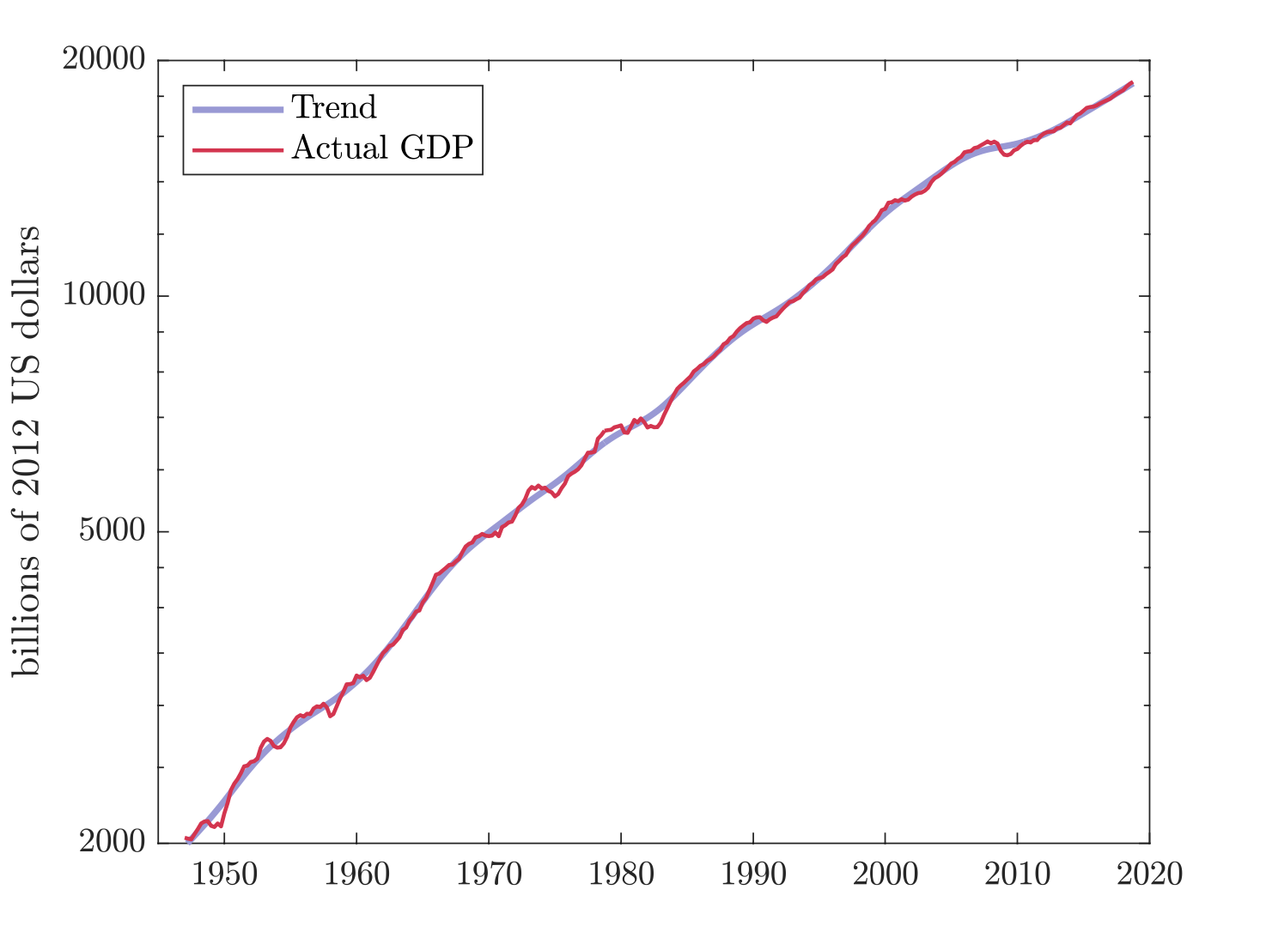
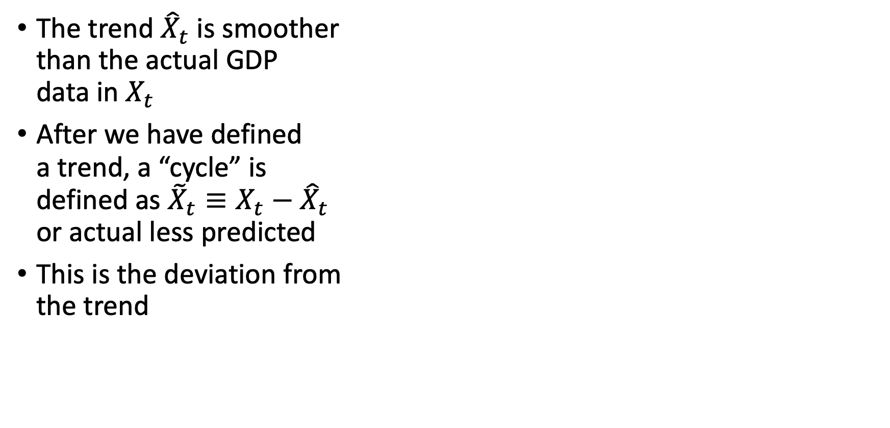
How is the business cycle determined?
The trend ${\hat{X}}_{t}$ is smoother than the actual GDP data in $X_{t}$
After we have defined a trend, a “cycle” is defined as ${\tilde{X}}_{t}≡X_{t}−{\hat{X}}_{t}$ or actual less predicted
This is the deviation from the trend

Slide 12
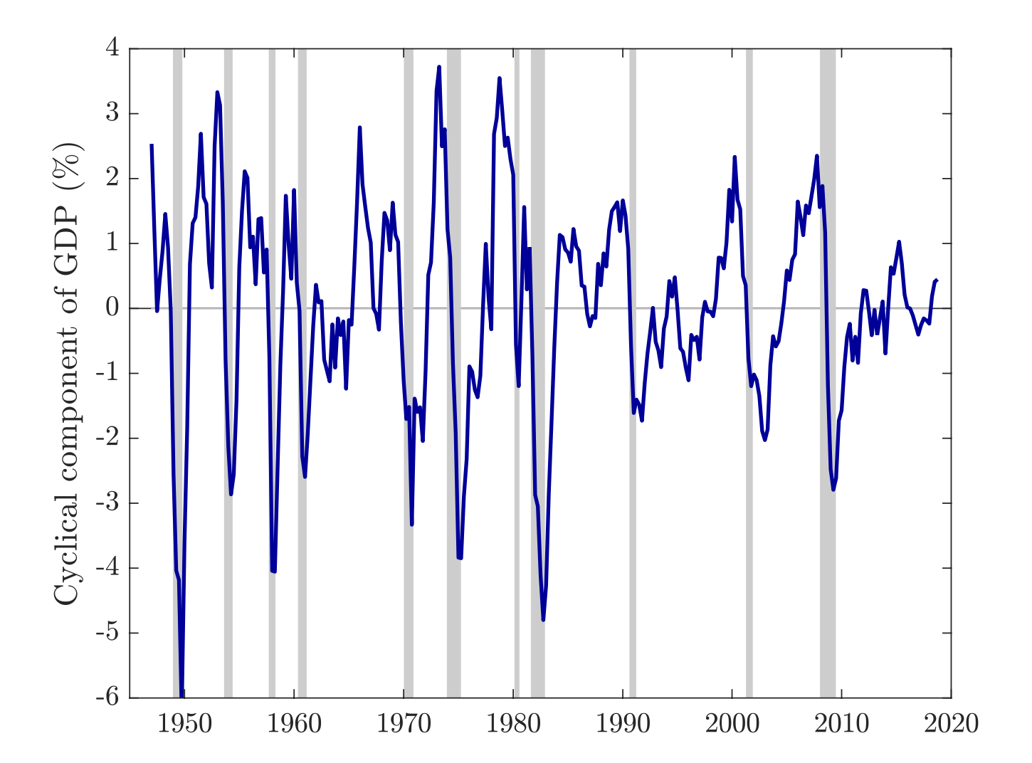
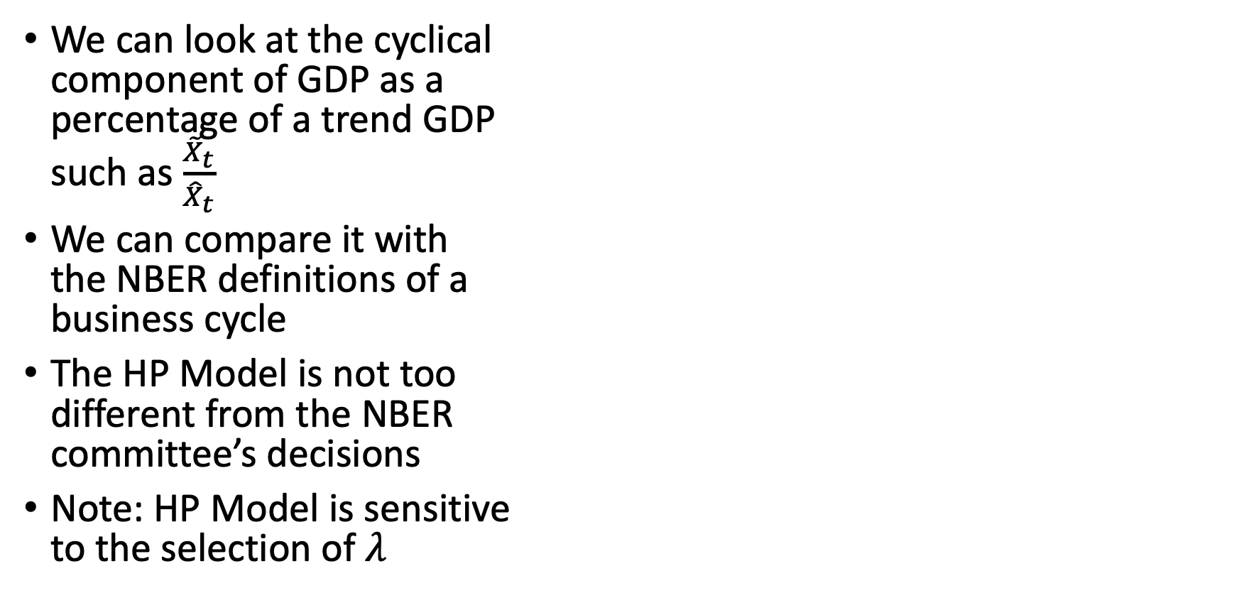
How is the business cycle determined?
We can look at the cyclical component of GDP as a percentage of a trend GDP such as $\frac{{\tilde{X}}_{t}}{{\hat{X}}_{t}}$
We can compare it with the NBER definitions of a business cycle
The HP Model is not too different from the NBER committee’s decisions
Note: HP Model is sensitive to the selection of $λ$

Slide 13
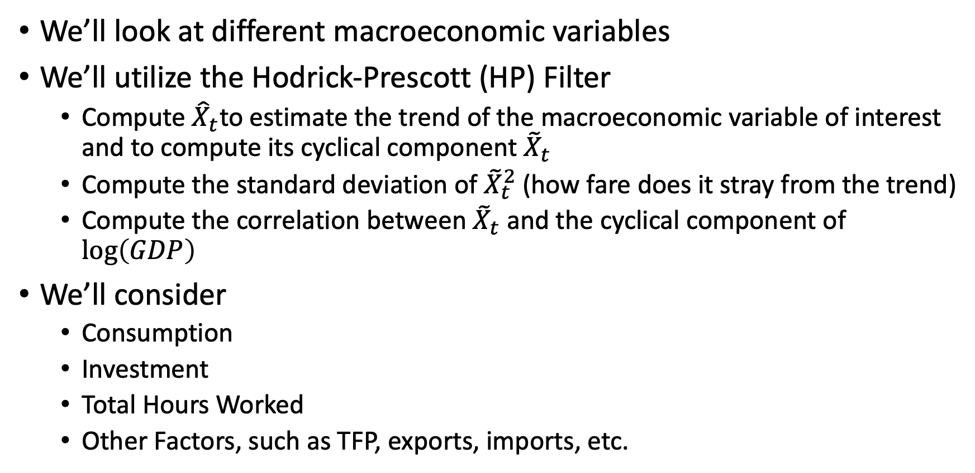
Post-WWII US Business Cycles
We’ll look at different macroeconomic variables
We’ll utilize the Hodrick-Prescott (HP) Filter
Compute ${\hat{X}}_{t}$to estimate the trend of the macroeconomic variable of interest and to compute its cyclical component ${\tilde{X}}_{t}$
Compute the standard deviation of ${\tilde{X}}_{t}^{2}$ (how fare does it stray from the trend)
Compute the correlation between ${\tilde{X}}_{t}$ and the cyclical component of $\log\left(GDP\right)$
We’ll consider
Consumption
Investment
Total Hours Worked
Other Factors, such as TFP, exports, imports, etc.

Slide 14
Post-WWII US Business Cycles
Variable | Standard Deviation | Relative Standard Deviation | Correlation with GDP
GDP | 1.6% | 1 | 1
Consumption | 1.2% | 0.74 | 0.78
Durable Goods | 4.7% | 2.93 | 0.60
Non-durable Goods | 1.5% | 0.95 | 0.58
Services | 0.8% | 0.54 | 0.57
Investment | 7.3% | 4.59 | 0.83
Government Spending | 3.3% | 2.06 | 0.16
Exports | 5.3% | 3.31 | 0.42
Imports | 5.0% | 3.12 | 0.72

Slide 15
Post-WWII US Business Cycles
Variable | Standard Deviation | Relative Standard Deviation | Correlation with GDP
GDP | 1.6% | 1 | 1
Total Hours Worked | 1.8% | 1.13 | 0.85
TFP (Solow Residual) | 1.3% | 0.78 | 0.80
Real Wages | 0.7% | 0.47 | 0.31
Unemployment Rate | 0.8% |  | -0.86
Inflation | 3.2% |  | 0.26
Nominal Interest Rate | 1.1% |  | 0.38

Slide 16
Post-WWII US Business Cycles
Straying from trend – less volatile
GDP may move 1.6% away from its trend (above or below)
Consumption only stray 1.2% from its trend
Non-durable goods and services are less volatile at 1.5% and 0.8%
TFP (Solow residual) and real wages are less volatile at 1.3% and 0.7%
Unemployment doesn’t stray too far from its trend at 0.8%
Straying from trend – more volatile
Durable goods may trend 4.7% away from its trend
Investments may trend 7.3%
Exports and Imports move 5.0% an 5.3% respectively

Slide 17
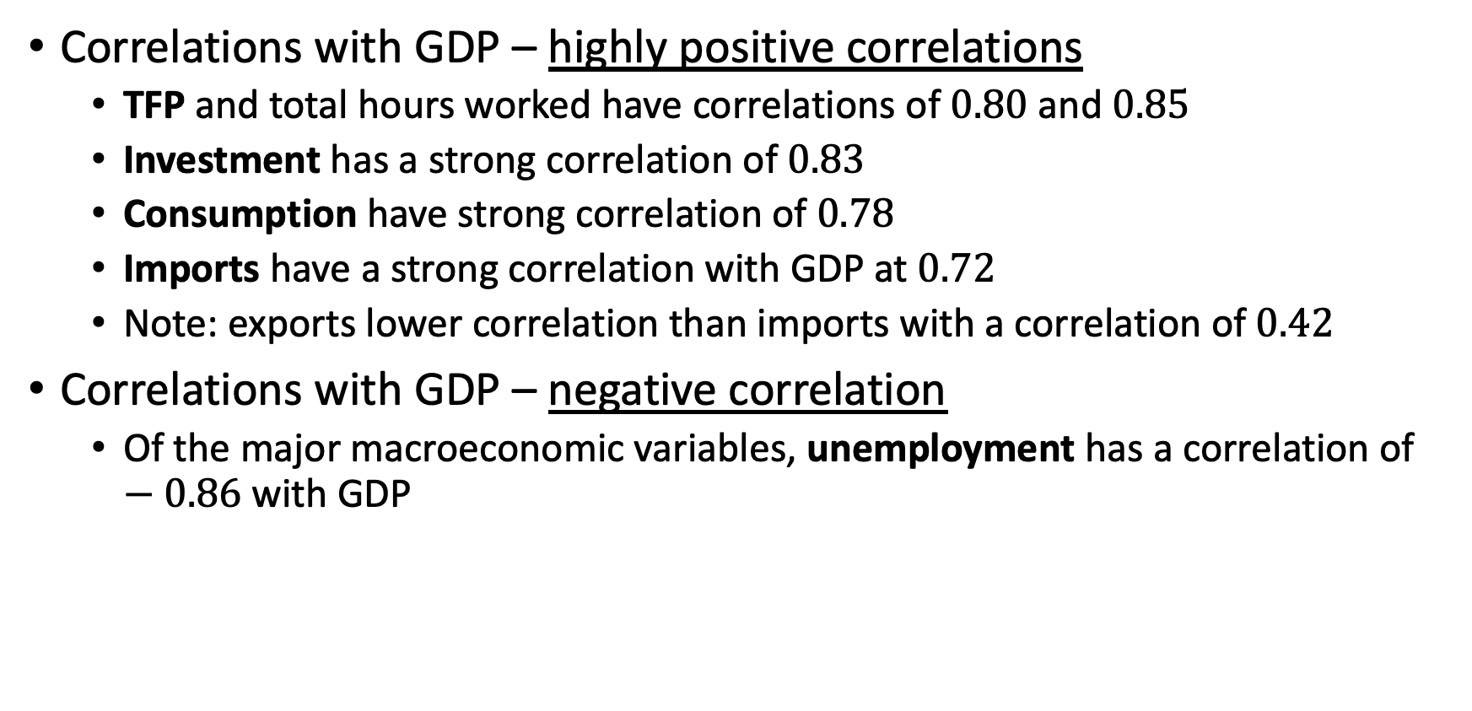
Post-WWII US Business Cycles
Correlations with GDP – highly positive correlations
TFP and total hours worked have correlations of $0.80$ and $0.85$
Investment has a strong correlation of $0.83$
Consumption have strong correlation of $0.78$
Imports have a strong correlation with GDP at $0.72$
Note: exports lower correlation than imports with a correlation of $0.42$
Correlations with GDP – negative correlation
Of the major macroeconomic variables, unemployment has a correlation of $−0.86$ with GDP

Slide 18
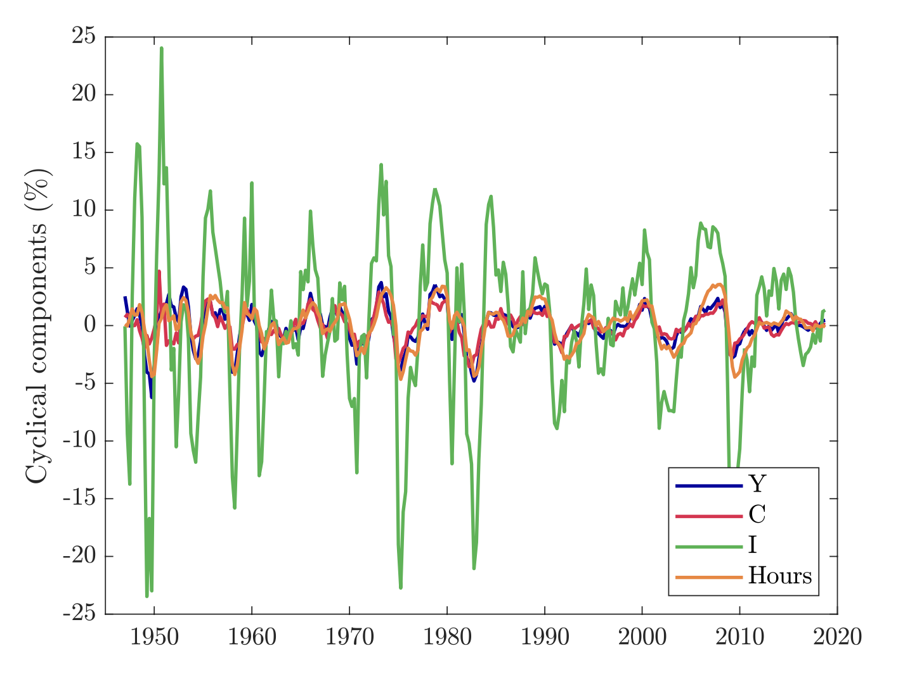
Post-WWII US Business Cycles
We can see that the cyclical trends of consumption, investment, and hours move closely with GDP
Investments are more volatile

Slide 19
The Phillips Curve
Phillips (1958) documented a relationship between the rate of nominal wage increases and the unemployment rate
The Phillips Curve
There is a negative relationship between inflation and unemployment
Times of low unemployment were also times of fast wage growth
There are different versions
The association has varied over time
There was a clear negative relationship in the 1960s, and late 1970s-1980s
The relationship after mid-1980s was negative but weaker
There was stagflation in the 1970s
We’ll come back to this with when covering expectations

Slide 20
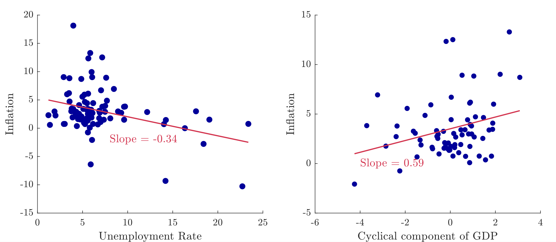
The Phillips Curve

Slide 21
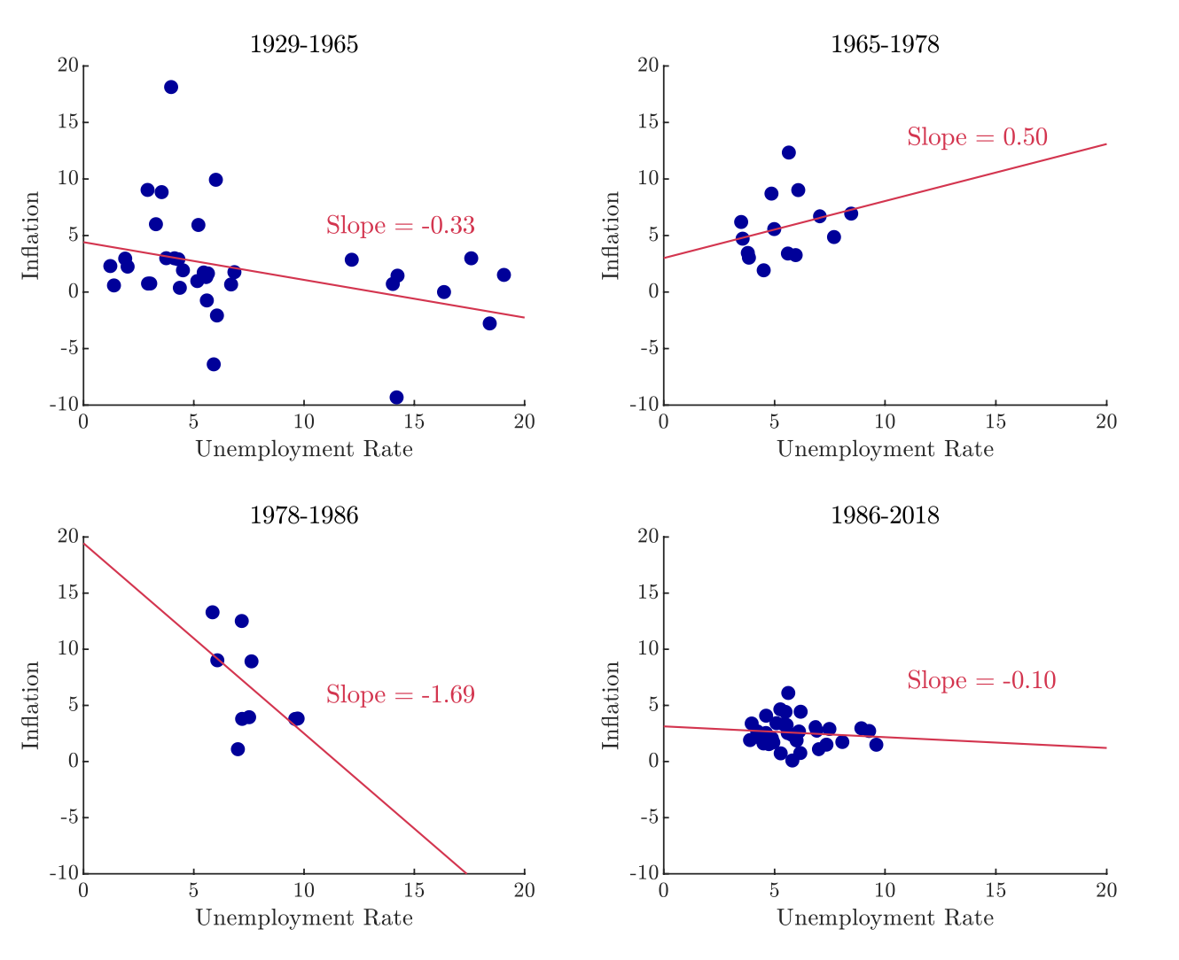
The Phillips Curve
Note: We may not see much of a relationship between levels of inflation and unemployment.
However, if we look at the rate of change in inflation and unemployment we’ll see a much stronger relationship.

Slide 22
The Great Depression
Understanding the Great Depression was an important motivation in macroeconomics
Was the Great Depression another business cycle or a fundamentally different phenomenon?
Between the peak of the business cycle in 1929 to its trough in 1933
Real GDP fell by 27%
Investment fell by 80%
Unemployment rose from 5% to 20%
Prices dropped 27%
Observations – the magnitude of movements were higher than typical
Investment fell more than GDP
Unemployment rose the same time as GDP fell
Deflation occurred as expected from the Phillips Curve

Slide 23
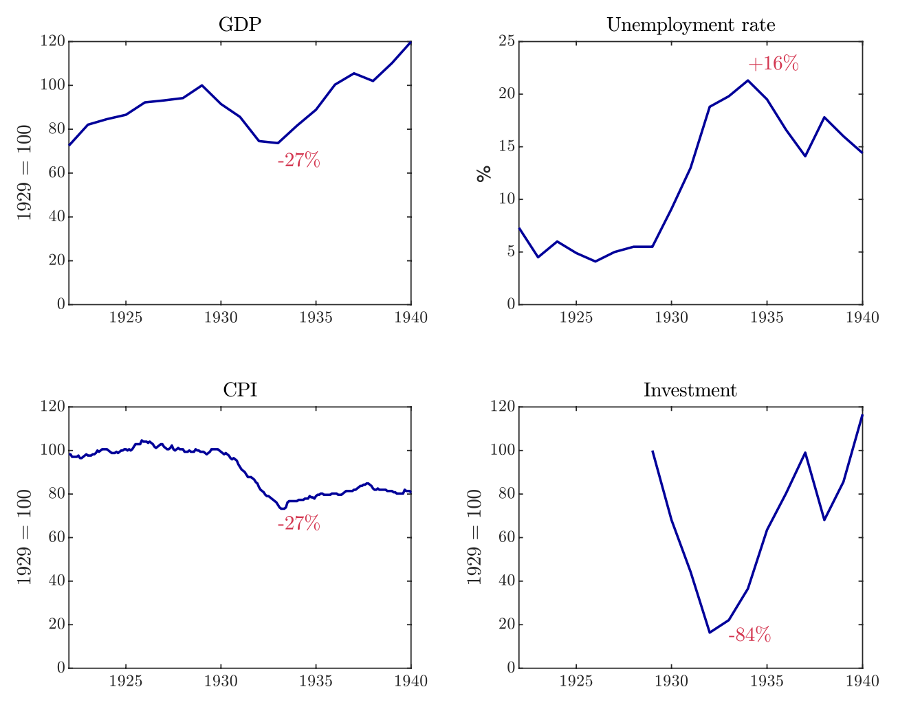
The Great Depression

Slide 24
The Real Business Cycle Model
Kurlat Chapter 13

Slide 25
Overview
We will cover a few models of business cycles
Our first one will be the Real Business Cycle Model
Key features
It looks at real values only
It does not include money or nominal values
We will maintain the assumption that markets are competitive
We’ll pick up where we ended with General Equilibrium
We’ll simply General Equilibrium
We’ll look at shocks (or exogenous changes)
We’ll then look at how endogenous, output, employment, investment, etc. variables respond to the exogenous shock

Slide 26
Two-Period Model

Slide 27
Simplify our General Equilibrium
We’ll start with our two-period economy with general equilibrium
Simplifying assumptions
1) The economy has no capital in period 1
2) The production function only uses labor in period 1
3) The production function only uses capital in period 2
4) The economy has competitive markets and no externalities
Why are we doing this?
We are trying to understand behavior in period 1
Also, at any point in time, capital stock are the results from past decisions and cannot be changed

Slide 28
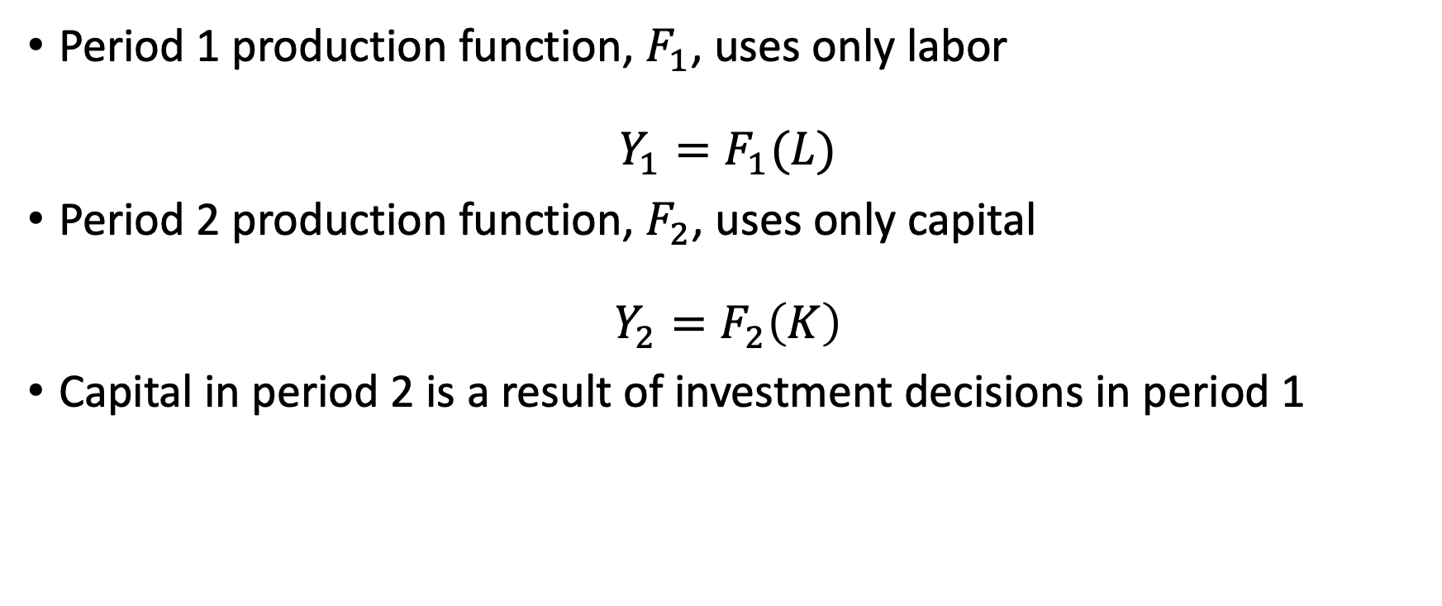
Simplify our General Equilibrium
Period 1 production function, $F_{1}$, uses only labor
$$Y_{1}=F_{1}(L)$$
Period 2 production function, $F_{2}$, uses only capital
$$Y_{2}=F_{2}\left(K\right)$$
Capital in period 2 is a result of investment decisions in period 1

Slide 29
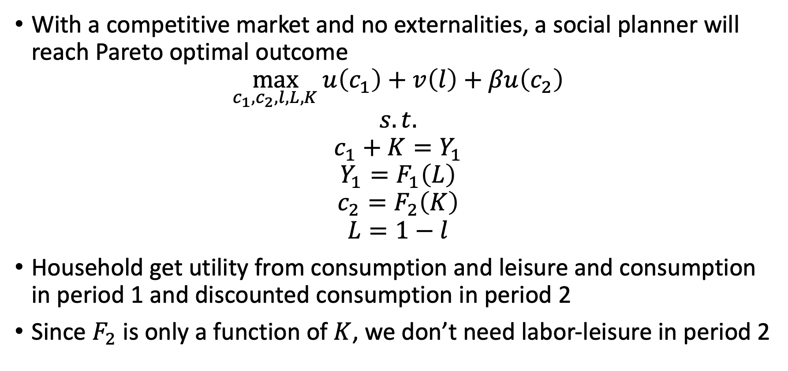
Simplify our General Equilibrium
With a competitive market and no externalities, a social planner will reach Pareto optimal outcome
$$\max_{c_{1},c_{2},l,L,K}{u\left(c_{1}\right)+v\left(l\right)+βu\left(c_{2}\right)}$$
$$s.t.$$
$$c_{1}+K=Y_{1}$$
$$Y_{1}=F_{1}\left(L\right)$$
$$c_{2}=F_{2}\left(K\right)$$
$$L=1−l$$
Household get utility from consumption and leisure and consumption in period 1 and discounted consumption in period 2
Since $F_{2}$ is only a function of $K$, we don’t need labor-leisure in period 2

Slide 30
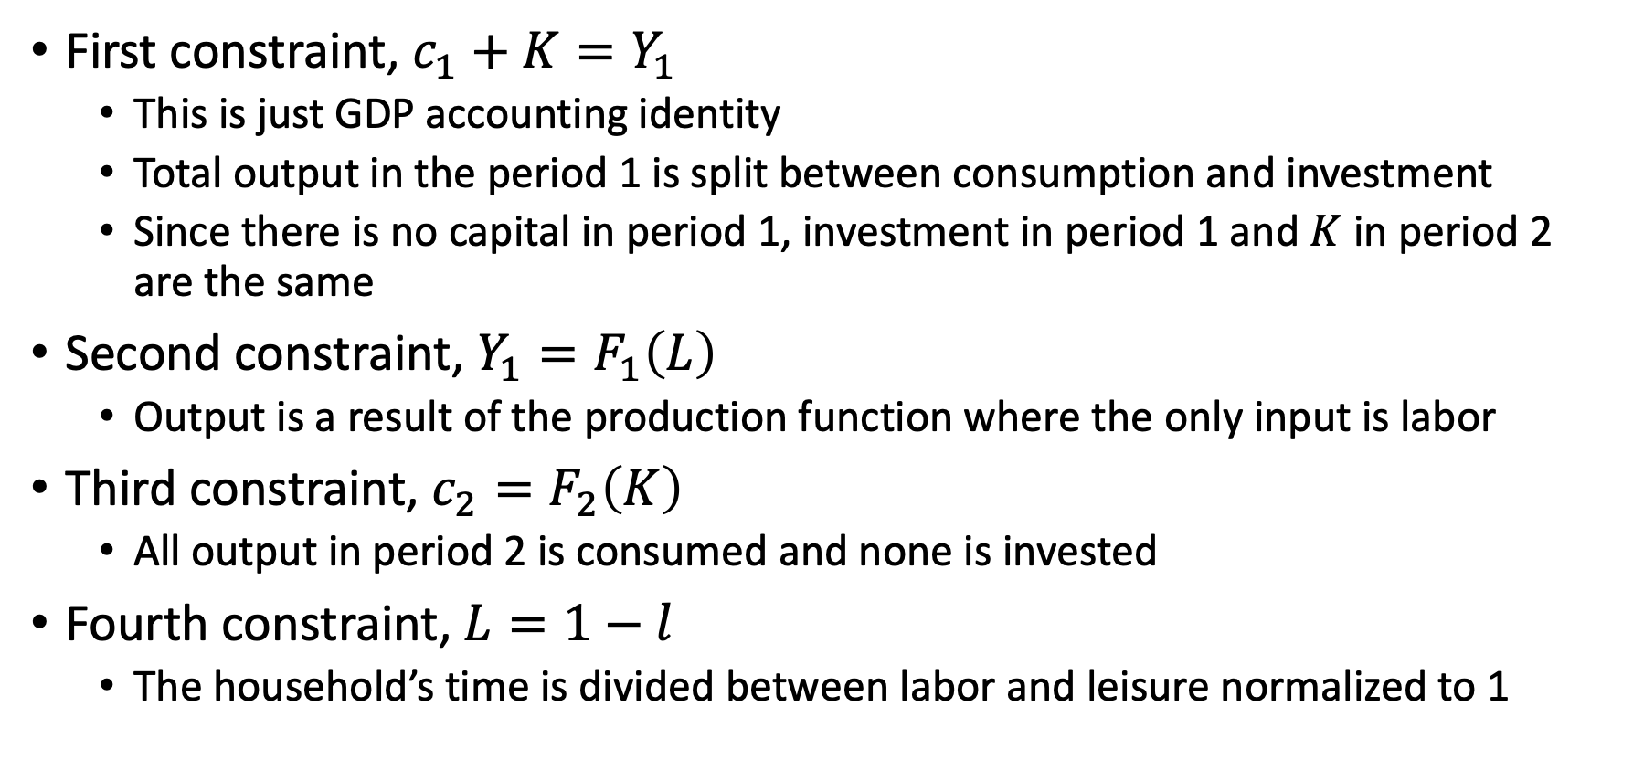
Simplify our General Equilibrium
First constraint, $c_{1}+K=Y_{1}$
This is just GDP accounting identity
Total output in the period 1 is split between consumption and investment
Since there is no capital in period 1, investment in period 1 and $K$ in period 2 are the same
Second constraint, $Y_{1}=F_{1}\left(L\right)$
Output is a result of the production function where the only input is labor
Third constraint, $c_{2}=F_{2}\left(K\right)$
All output in period 2 is consumed and none is invested
Fourth constraint, $L=1−l$
The household’s time is divided between labor and leisure normalized to 1

Slide 31
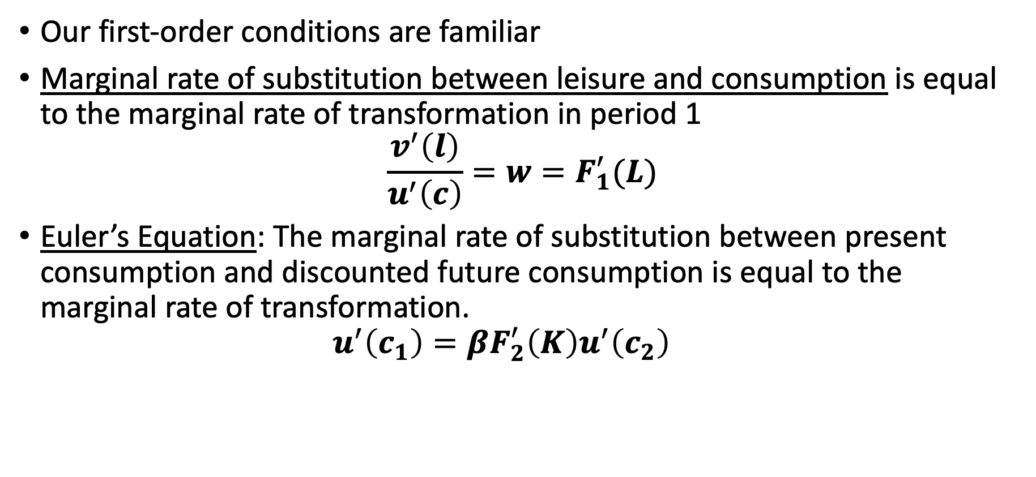
Simplify our General Equilibrium
Our first-order conditions are familiar
Marginal rate of substitution between leisure and consumption is equal to the marginal rate of transformation in period 1
$$\frac{v^{′}\left(l\right)}{u^{′}\left(c\right)}=w=F_{1}^{′}(L)$$
Euler’s Equation: The marginal rate of substitution between present consumption and discounted future consumption is equal to the marginal rate of transformation.
$$u^{′}\left(c_{1}\right)=βF_{2}^{′}\left(K\right)u^{′}\left(c_{2}\right)$$

Slide 32
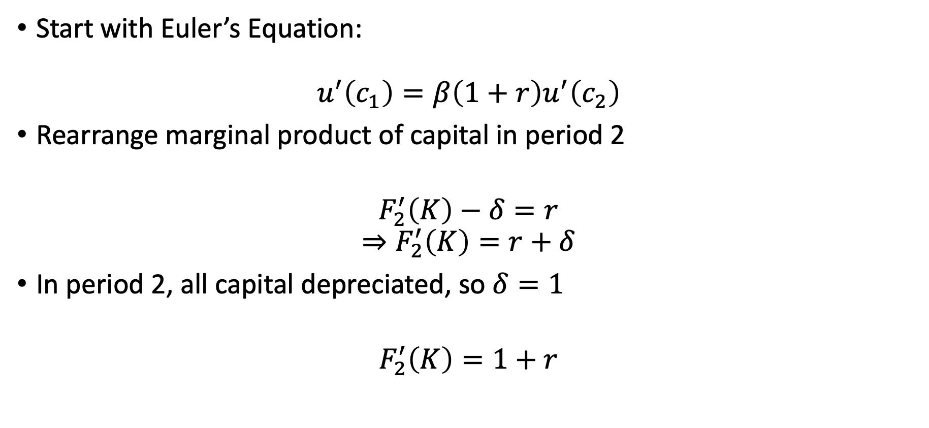
Simplify our General Equilibrium
Start with Euler’s Equation:
$$u^{′}\left(c_{1}\right)=β\left(1+r\right)u^{′}\left(c_{2}\right)$$
Rearrange marginal product of capital in period 2
$$F_{2}^{′}\left(K\right)−δ=r$$
$$⇒F_{2}^{′}\left(K\right)=r+δ$$
In period 2, all capital depreciated, so $δ=1$
$$F_{2}^{′}\left(K\right)=1+r$$

Slide 33
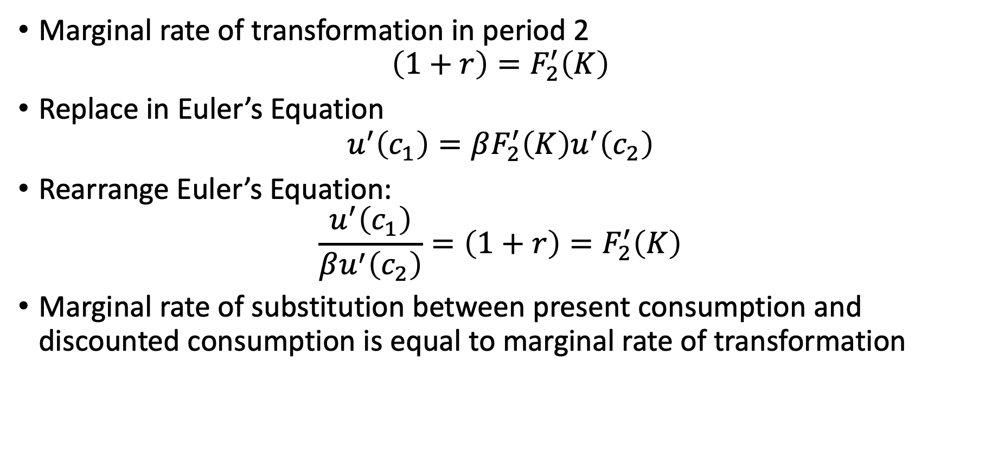
Simplify our General Equilibrium
Marginal rate of transformation in period 2
$$\left(1+r\right)=F_{2}^{′}\left(K\right)$$
Replace in Euler’s Equation
$$u^{′}\left(c_{1}\right)=βF_{2}^{′}\left(K\right)u^{′}\left(c_{2}\right)$$
Rearrange Euler’s Equation:
$$\frac{u^{′}\left(c_{1}\right)}{βu^{′}\left(c_{2}\right)}=\left(1+r\right)=F_{2}^{′}\left(K\right)$$
Marginal rate of substitution between present consumption and discounted consumption is equal to marginal rate of transformation

Slide 34
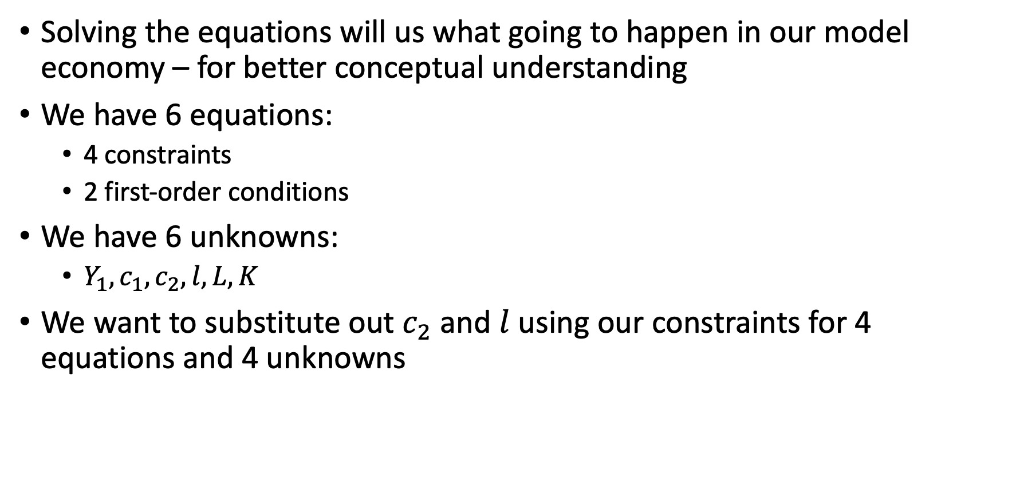
Simplify our General Equilibrium
Solving the equations will us what going to happen in our model economy – for better conceptual understanding
We have 6 equations:
4 constraints
2 first-order conditions
We have 6 unknowns:
$Y_{1}, c_{1}, c_{2},l,L,K$
We want to substitute out $c_{2}$ and $l$ using our constraints for 4 equations and 4 unknowns

Slide 35
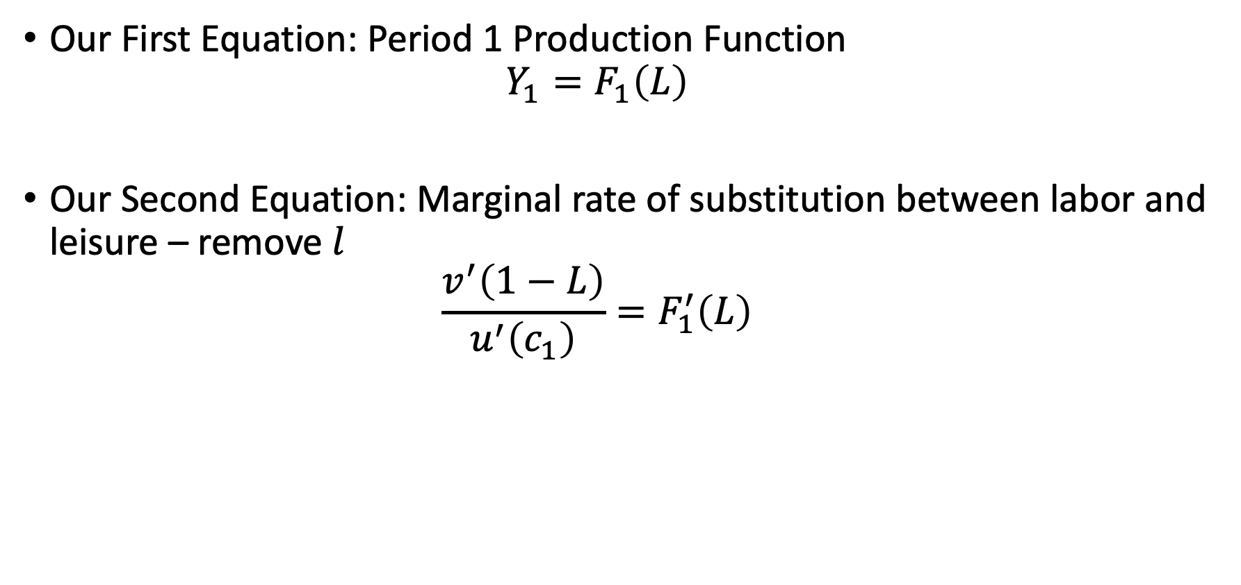
Simplify our General Equilibrium
Our First Equation: Period 1 Production Function
$$Y_{1}=F_{1}\left(L\right)$$
Our Second Equation: Marginal rate of substitution between labor and leisure – remove $l$
$$\frac{v^{′}\left(1−L\right)}{u^{′}\left(c_{1}\right)}=F_{1}^{′}\left(L\right)$$

Slide 36
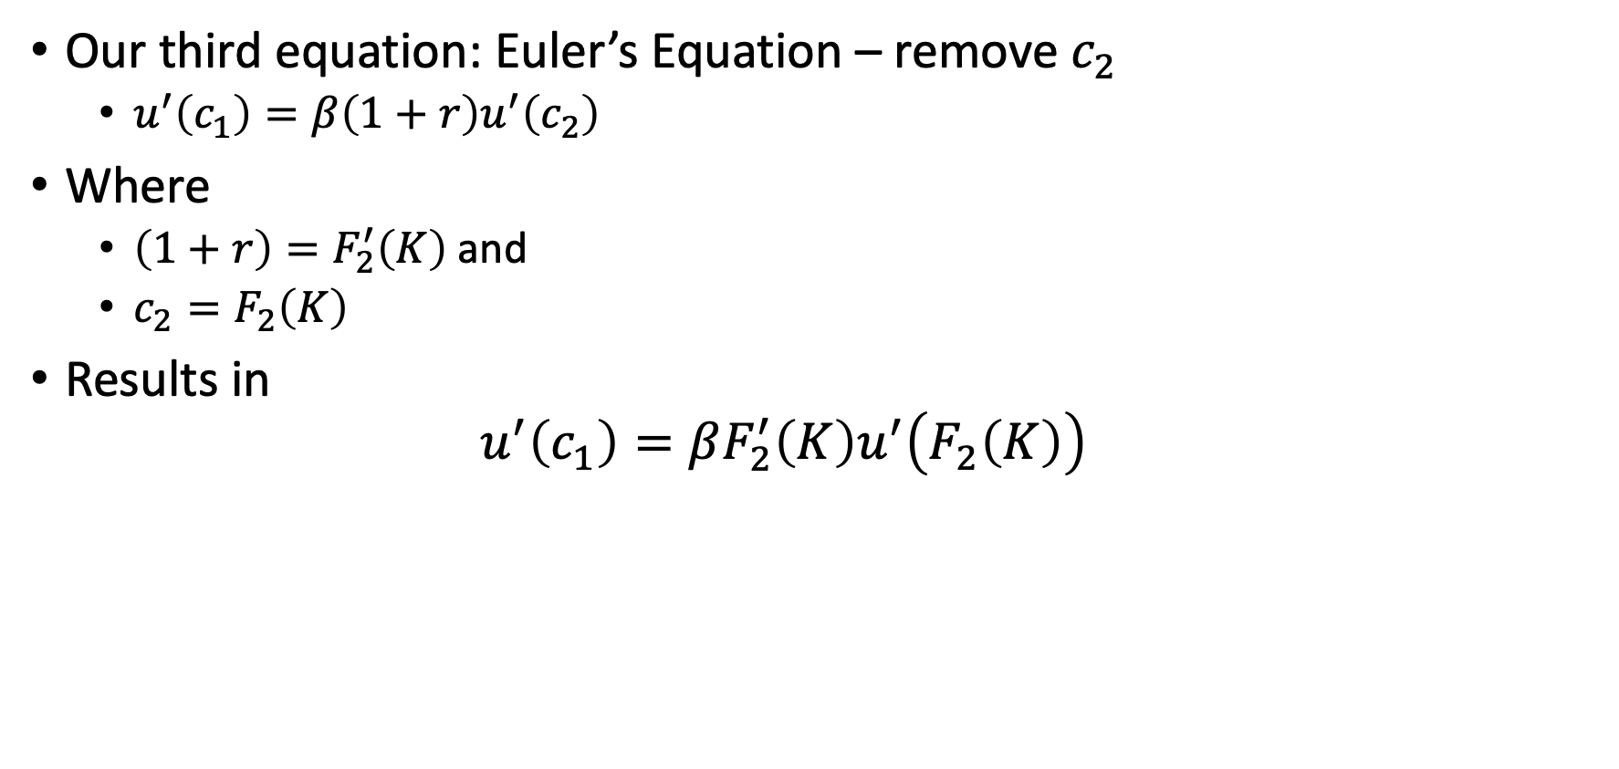
Simplify our General Equilibrium
Our third equation: Euler’s Equation – remove $c_{2}$
$u^{′}\left(c_{1}\right)=β\left(1+r\right)u^{′}\left(c_{2}\right)$
Where
$\left(1+r\right)=F_{2}^{′}\left(K\right)$ and
$c_{2}=F_{2}\left(K\right)$
Results in
$$u^{′}\left(c_{1}\right)=βF_{2}^{′}\left(K\right)u^{′}\left(F_{2}\left(K\right)\right)$$

Slide 37
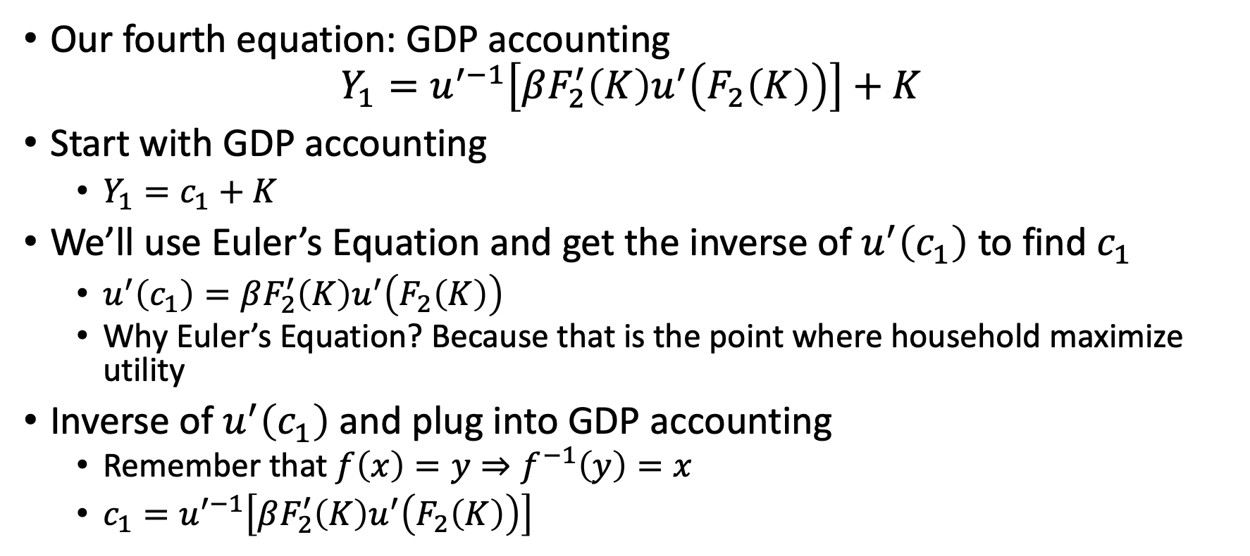
Simplify our General Equilibrium
Our fourth equation: GDP accounting
$$Y_{1}=u^{′−1}\left[βF_{2}^{′}\left(K\right)u^{′}\left(F_{2}\left(K\right)\right)\right]+K$$
Start with GDP accounting
$Y_{1}=c_{1}+K$
We’ll use Euler’s Equation and get the inverse of $u^{′}\left(c_{1}\right)$ to find $c_{1}$
$u^{′}\left(c_{1}\right)=βF_{2}^{′}\left(K\right)u^{′}\left(F_{2}\left(K\right)\right)$
Why Euler’s Equation? Because that is the point where household maximize utility
Inverse of $u^{′}\left(c_{1}\right)$ and plug into GDP accounting
Remember that $f\left(x\right)=y⇒f^{−1}\left(y\right)=x$
$c_{1}=u^{′−1}\left[βF_{2}^{′}\left(K\right)u^{′}\left(F_{2}\left(K\right)\right)\right]$

Slide 38
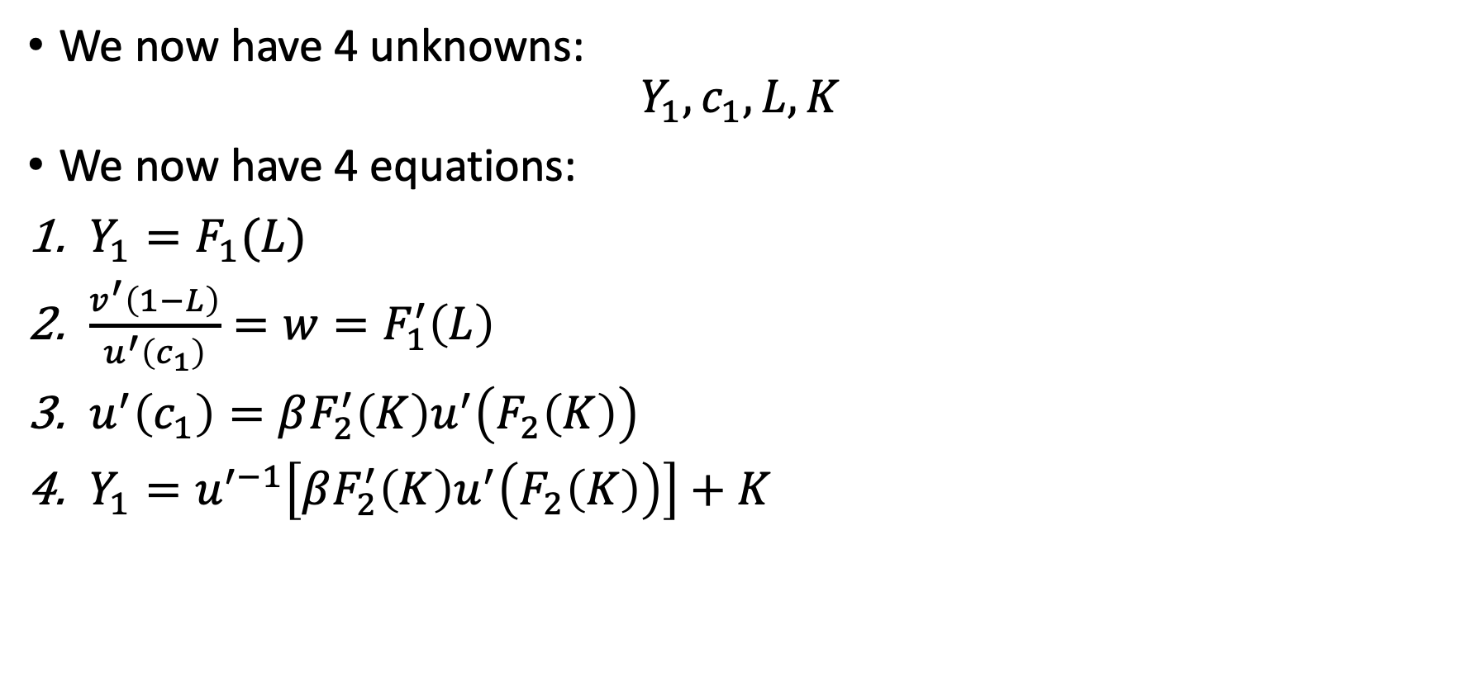
Two-Period Model
We now have 4 unknowns:
$$Y_{1},c_{1},L,K$$
We now have 4 equations:
$Y_{1}=F_{1}(L)$
$\frac{v^{′}\left(1−L\right)}{u^{′}\left(c_{1}\right)}=w=F_{1}^{′}\left(L\right)$
$u^{′}\left(c_{1}\right)=βF_{2}^{′}\left(K\right)u^{′}\left(F_{2}\left(K\right)\right)$
$Y_{1}=u^{′−1}\left[βF_{2}^{′}\left(K\right)u^{′}\left(F_{2}\left(K\right)\right)\right]+K$

Slide 39
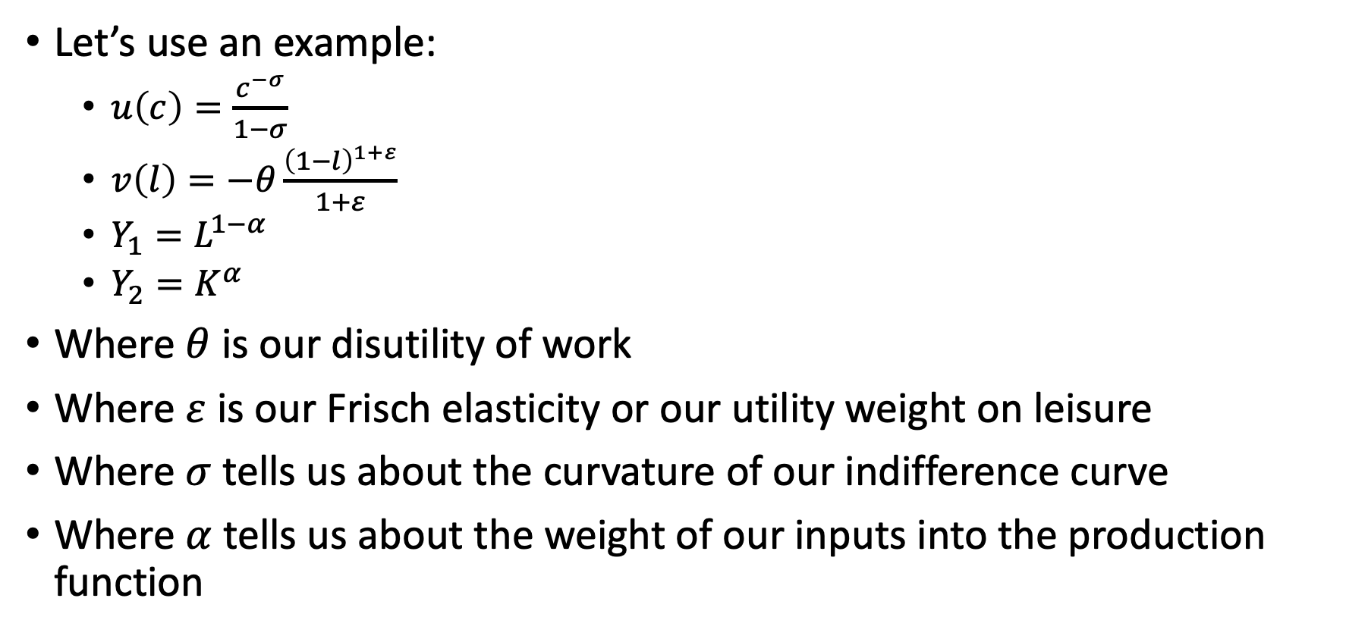
Two-Period Model
Let’s use an example:
$u\left(c\right)=\frac{c^{−σ}}{1−σ}$
$v\left(l\right)=−θ\frac{{\left(1−l\right)}^{1+ε}}{1+ε}$
$Y_{1}=L^{1−α}$
$Y_{2}=K^{α}$
Where $θ$ is our disutility of work
Where $ε$ is our Frisch elasticity or our utility weight on leisure
Where $σ$ tells us about the curvature of our indifference curve
Where $α$ tells us about the weight of our inputs into the production function

Slide 40
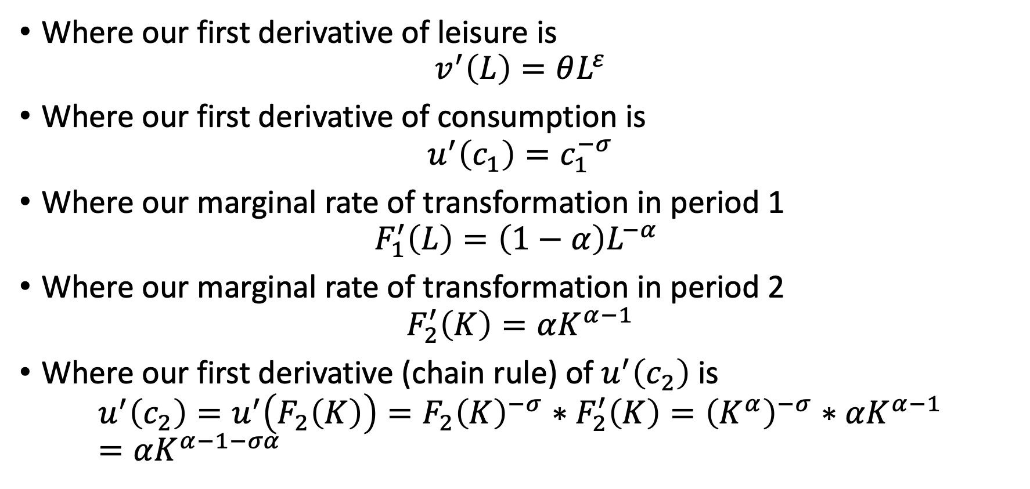
Two-Period Model
Where our first derivative of leisure is
$$v^{′}\left(L\right)=θL^{ε}$$
Where our first derivative of consumption is
$$u^{′}\left(c_{1}\right)=c_{1}^{−σ}$$
Where our marginal rate of transformation in period 1
$$F_{1}^{′}\left(L\right)=\left(1−α\right)L^{−α}$$
Where our marginal rate of transformation in period 2
$$F_{2}^{′}\left(K\right)=αK^{α−1}$$
Where our first derivative (chain rule) of $u^{′}\left(c_{2}\right)$ is $u^{′}\left(c_{2}\right)=u^{′}\left(F_{2}\left(K\right)\right)=F_{2}{\left(K\right)}^{−σ}∗F_{2}^{′}\left(K\right)={\left(K^{α}\right)}^{−σ}∗αK^{α−1}=αK^{α−1−σα}$

Slide 41
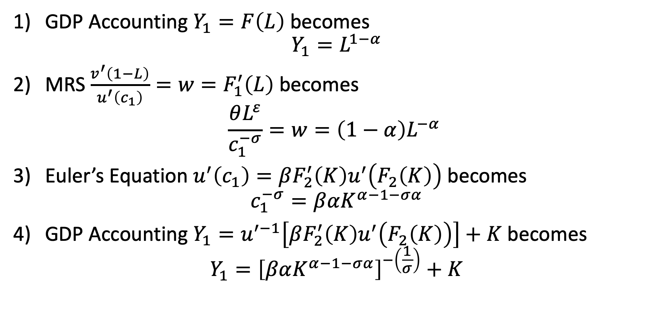
Four Equations in Two-Period Model
GDP Accounting $Y_{1}=F\left(L\right)$ becomes
$$Y_{1}=L^{1−α}$$
MRS $\frac{v^{′}\left(1−L\right)}{u^{′}\left(c_{1}\right)}=w=F_{1}^{′}\left(L\right)$ becomes
$$\frac{θL^{ε}}{c_{1}^{−σ}}=w=\left(1−α\right)L^{−α}$$
Euler’s Equation $u^{′}\left(c_{1}\right)=βF_{2}^{′}\left(K\right)u^{′}\left(F_{2}\left(K\right)\right)$ becomes
$$c_{1}^{−σ}=βαK^{α−1−σα}$$
GDP Accounting $Y_{1}=u^{′−1}\left[βF_{2}^{′}\left(K\right)u^{′}\left(F_{2}\left(K\right)\right)\right]+K$ becomes
$$Y_{1}={\left[βαK^{α−1−σα}\right]}^{−\left(\frac{1}{σ}\right)}+K$$

Slide 42
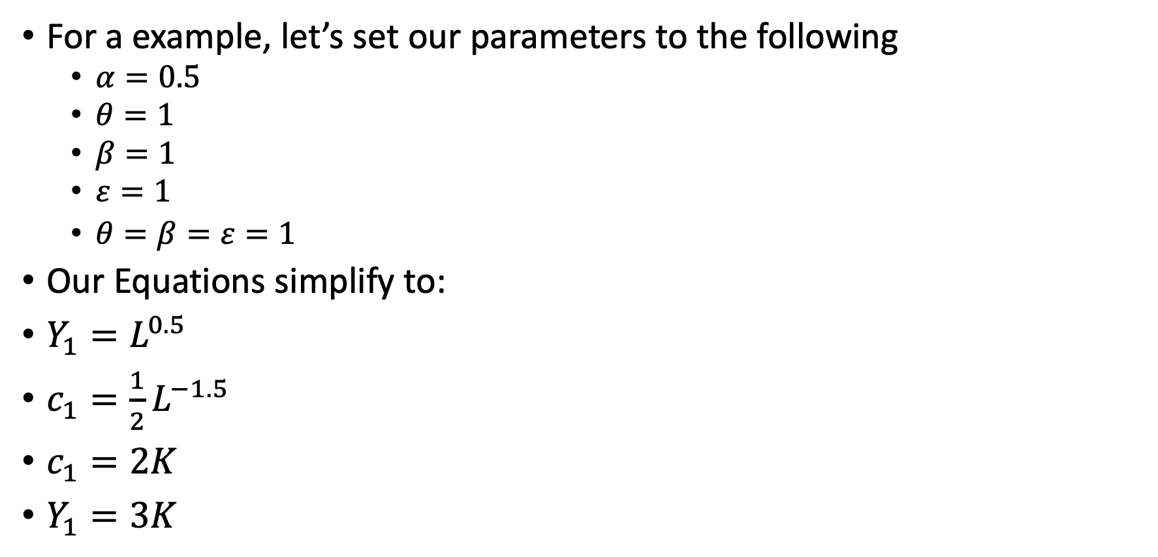
Two-Period Model
For a example, let’s set our parameters to the following
$α=0.5$
$θ=1$
$β=1$
$ε=1$
$θ=β=ε=1$
Our Equations simplify to:
$Y_{1}=L^{0.5}$
$c_{1}=\frac{1}{2}L^{−1.5}$
$c_{1}=2K$
$Y_{1}=3K$

Slide 43
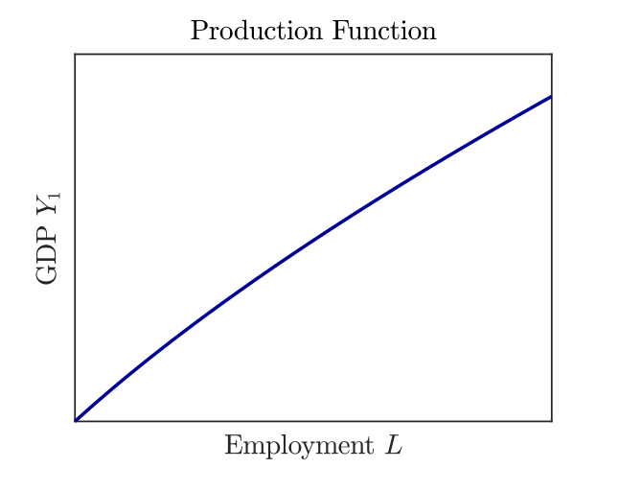
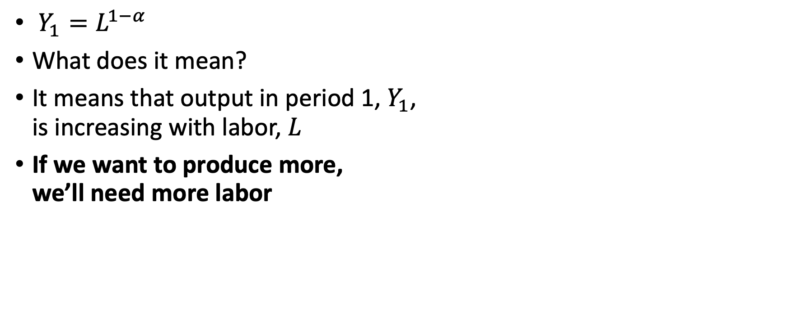
Production Function in Period 1
$Y_{1}=L^{1−α}$
What does it mean?
It means that output in period 1, $Y_{1}$, is increasing with labor, $L$
If we want to produce more, we’ll need more labor

Slide 44
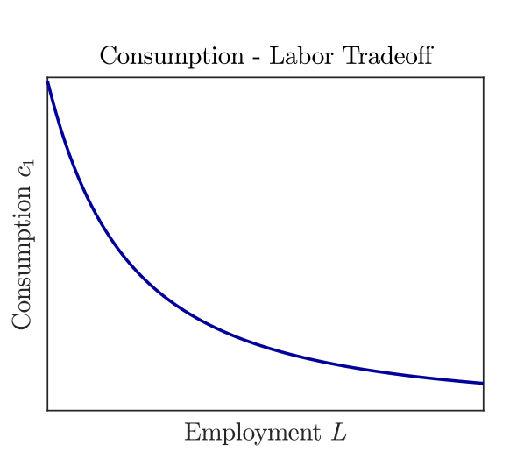
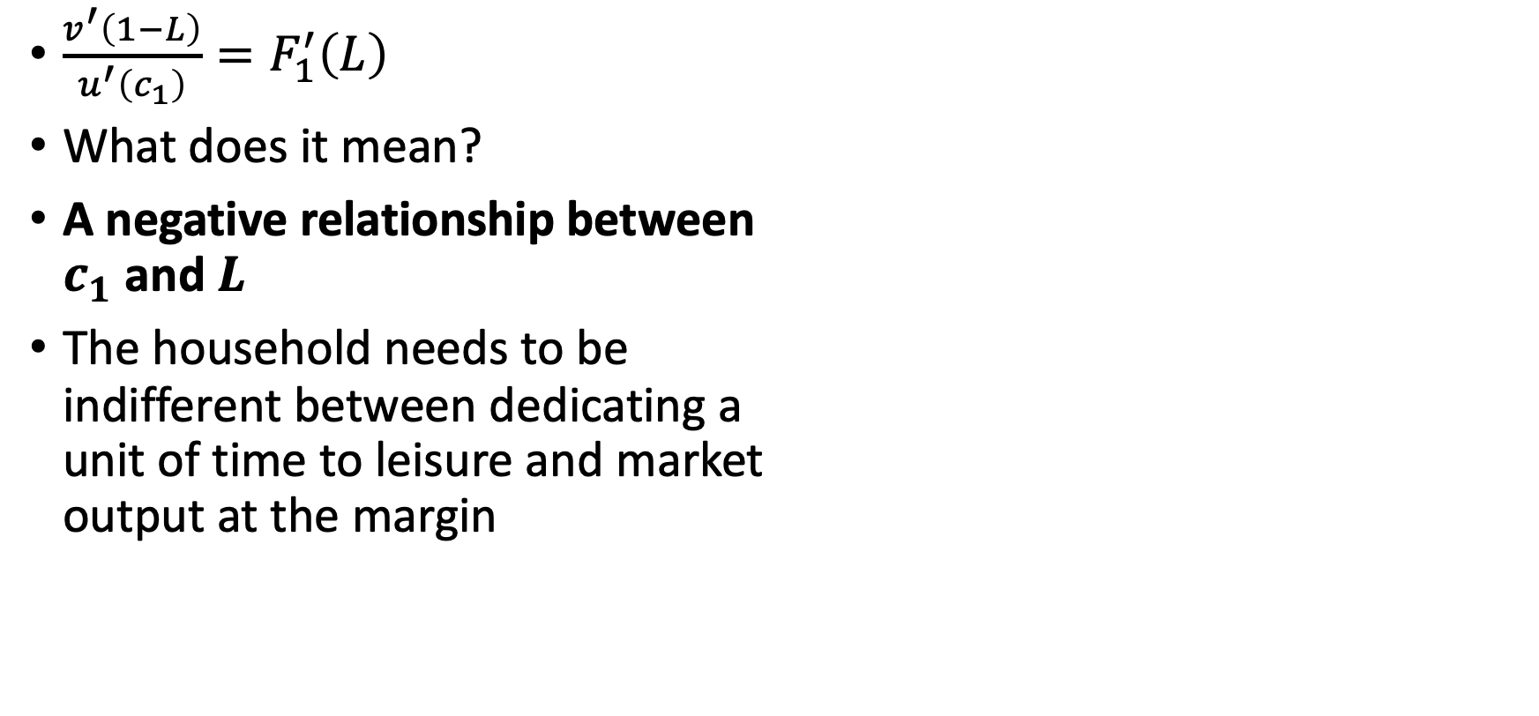
Consumption-Labor Tradeoff
$\frac{v^{′}\left(1−L\right)}{u^{′}\left(c_{1}\right)}=F_{1}^{′}\left(L\right)$
What does it mean?
A negative relationship between $c_{1}$ and $L$
The household needs to be indifferent between dedicating a unit of time to leisure and market output at the margin

Slide 45
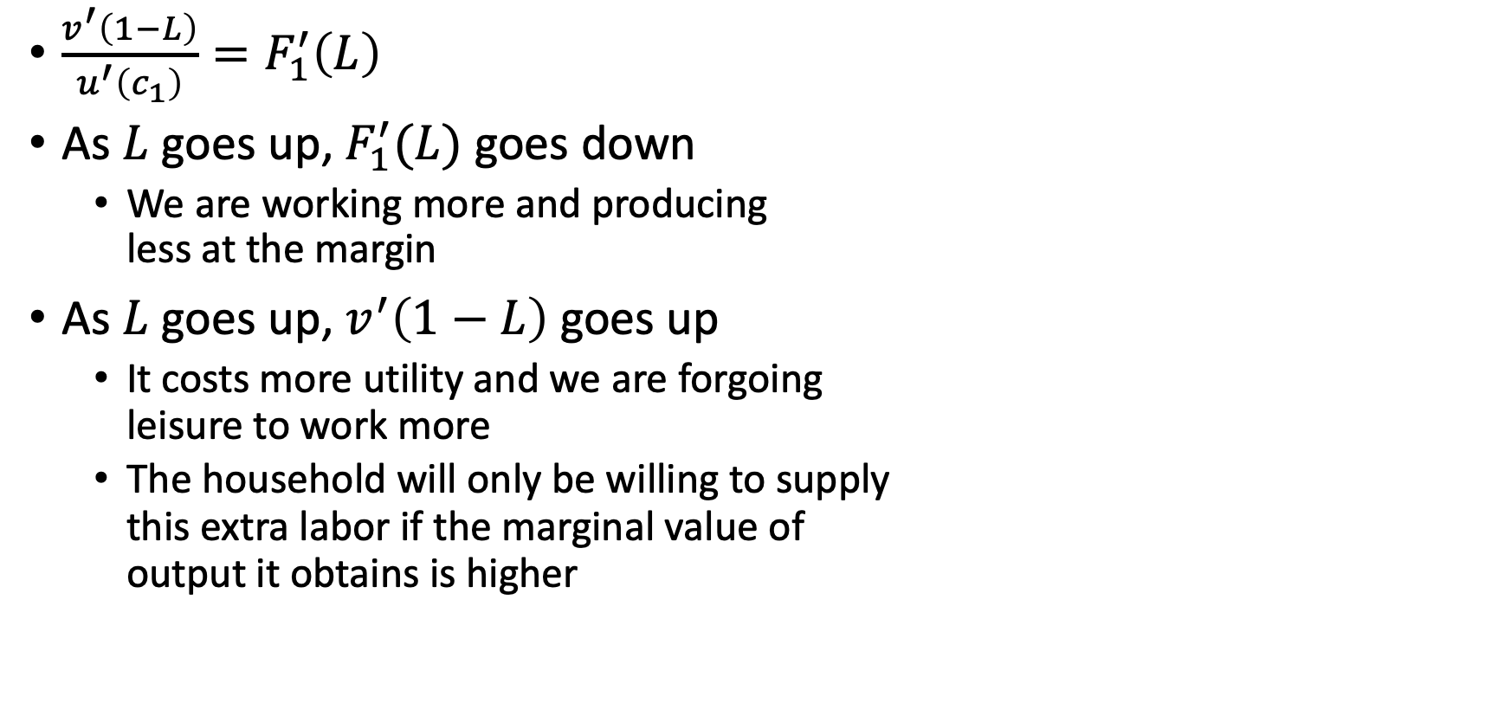
Consumption-Labor Tradeoff
$\frac{v^{′}\left(1−L\right)}{u^{′}\left(c_{1}\right)}=F_{1}^{′}\left(L\right)$
As $L$ goes up, $F_{1}^{′}(L)$ goes down
We are working more and producing less at the margin
As $L$ goes up, $v^{′}\left(1−L\right)$ goes up
It costs more utility and we are forgoing leisure to work more
The household will only be willing to supply this extra labor if the marginal value of output it obtains is higher

Slide 46
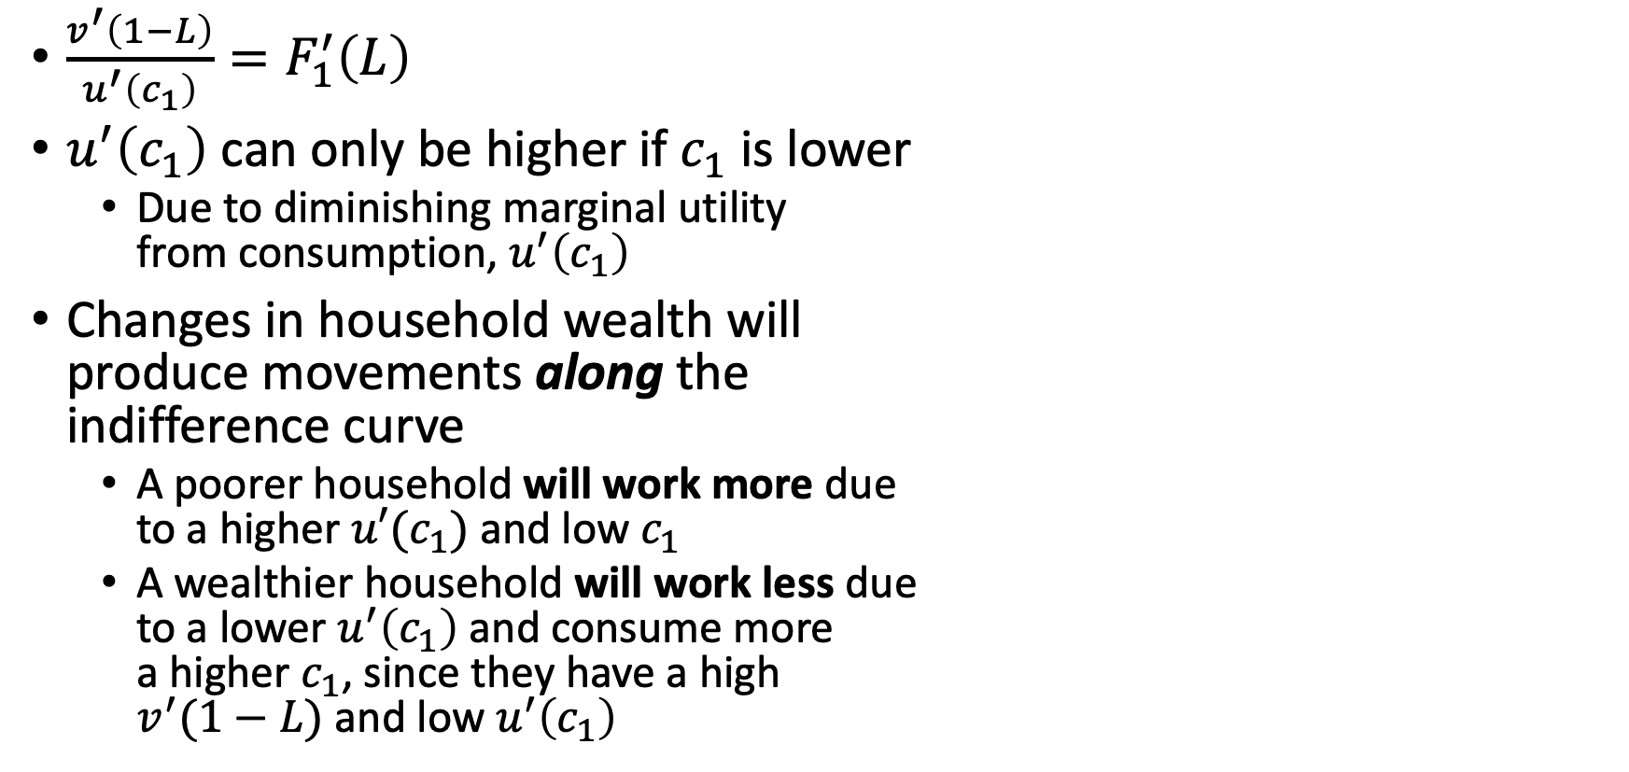
Consumption-Labor Tradeoff
$\frac{v^{′}\left(1−L\right)}{u^{′}\left(c_{1}\right)}=F_{1}^{′}\left(L\right)$
$u^{′}\left(c_{1}\right)$ can only be higher if $c_{1}$ is lower
Due to diminishing marginal utility from consumption, $u^{′}\left(c_{1}\right)$
Changes in household wealth will produce movements along the indifference curve
A poorer household will work more due to a higher ${u′(c}_{1})$and low $c_{1}$
A wealthier household will work less due to a lower $u^{′}\left(c_{1}\right)$ and consume more a higher $c_{1}$, since they have a high $v^{′}(1−L)$ and low $u^{′}\left(c_{1}\right)$

Slide 47
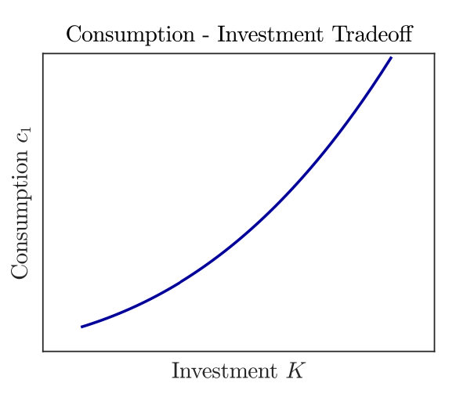
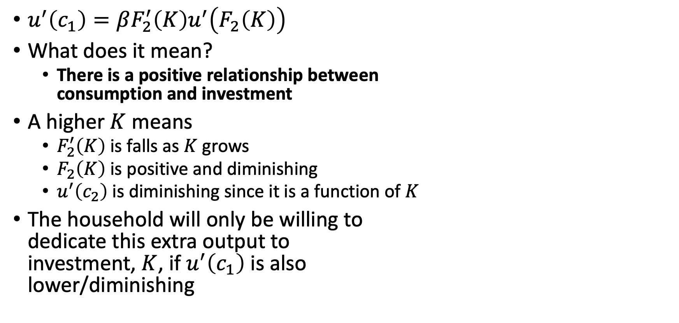
Consumption-Investment Tradeoff
$u^{′}\left(c_{1}\right)=βF_{2}^{′}\left(K\right)u^{′}\left(F_{2}\left(K\right)\right)$
What does it mean?
There is a positive relationship between consumption and investment
A higher $K$ means
$F_{2}^{′}\left(K\right)$ is falls as $K$ grows
$F_{2}\left(K\right)$ is positive and diminishing
$u^{′}\left(c_{2}\right)$ is diminishing since it is a function of $K$
The household will only be willing to dedicate this extra output to investment, $K$, if $u^{′}\left(c_{1}\right)$ is also lower/diminishing

Slide 48
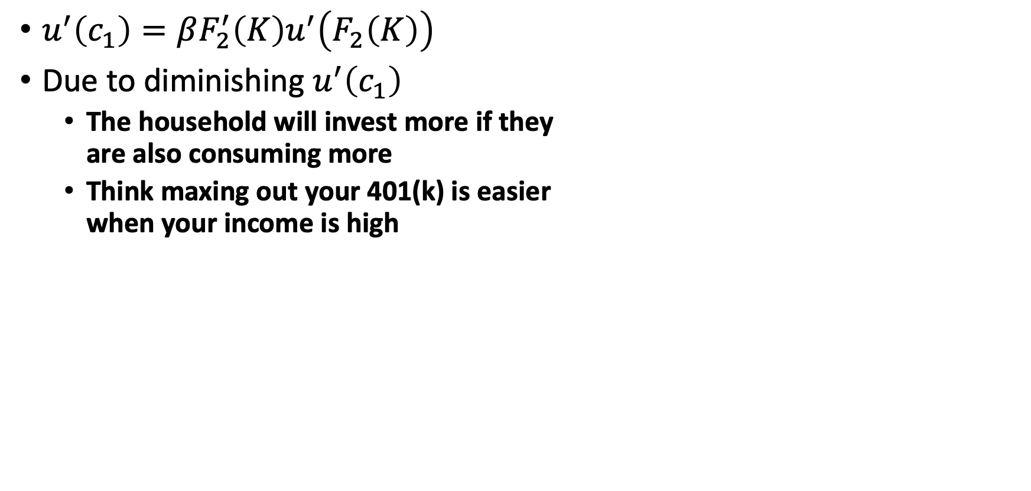
Consumption-Investment Tradeoff
$u^{′}\left(c_{1}\right)=βF_{2}^{′}\left(K\right)u^{′}\left(F_{2}\left(K\right)\right)$
Due to diminishing $u^{′}\left(c_{1}\right)$
The household will invest more if they are also consuming more
Think maxing out your 401(k) is easier when your income is high

Slide 49
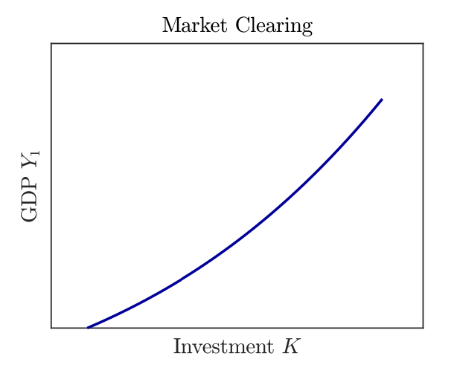
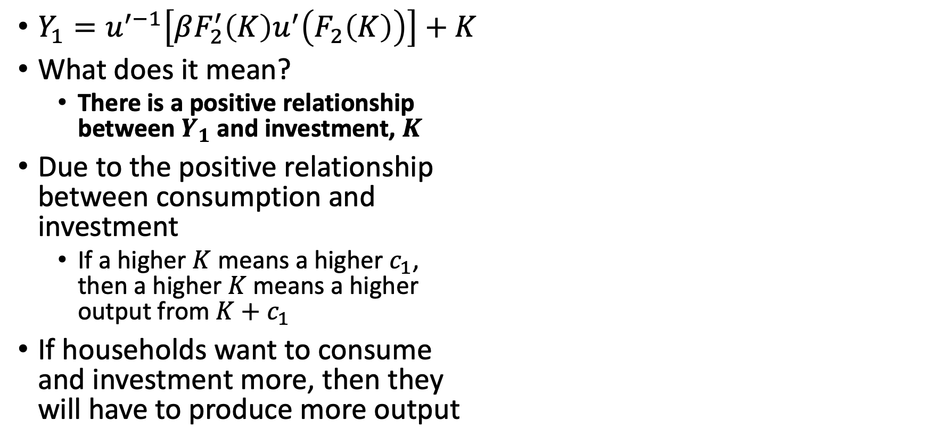
Market Clearing
$Y_{1}=u^{′−1}\left[βF_{2}^{′}\left(K\right)u^{′}\left(F_{2}\left(K\right)\right)\right]+K$
What does it mean?
There is a positive relationship between $Y_{1}$ and investment, $K$
Due to the positive relationship between consumption and investment
If a higher $K$ means a higher $c_{1}$, then a higher $K$ means a higher output from $K+c_{1}$
If households want to consume and investment more, then they will have to produce more output

Slide 50
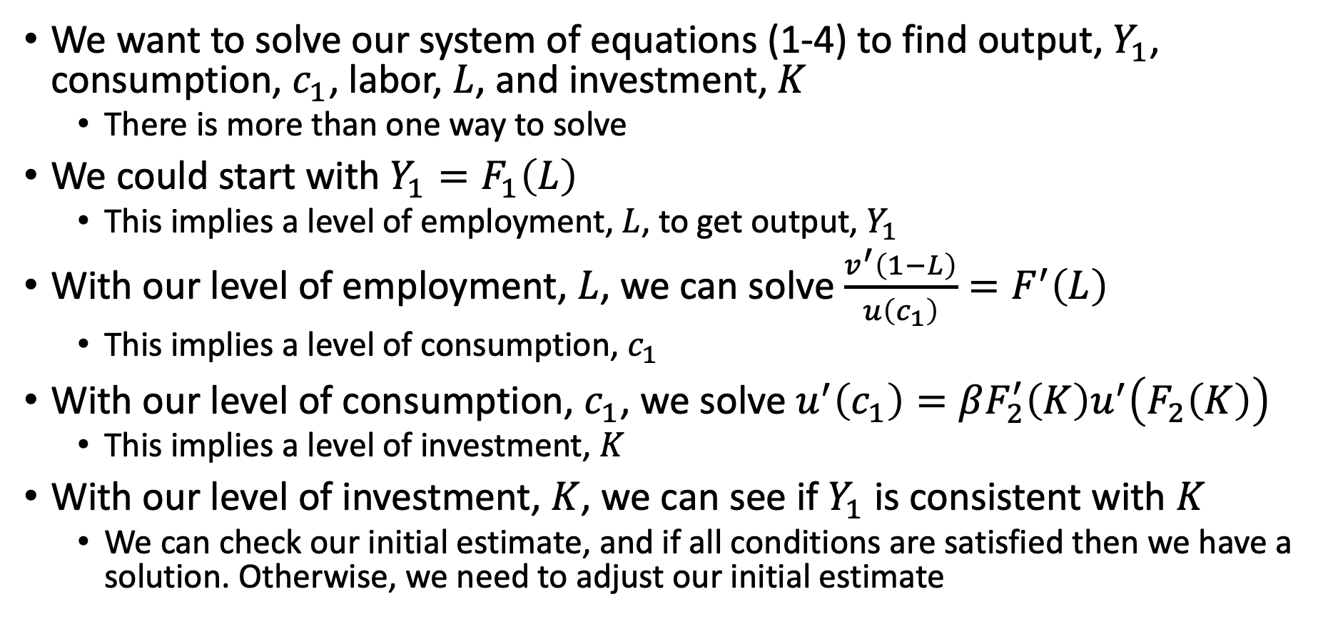
Two-Period Economy
We want to solve our system of equations (1-4) to find output, $Y_{1}$, consumption, $c_{1}$, labor, $L$, and investment, $K$
There is more than one way to solve
We could start with $Y_{1}=F_{1}\left(L\right)$
This implies a level of employment, $L$, to get output, $Y_{1}$
With our level of employment, $L$, we can solve $\frac{v^{′}\left(1−L\right)}{u\left(c_{1}\right)}=F^{′}\left(L\right)$
This implies a level of consumption, $c_{1}$
With our level of consumption, $c_{1}$, we solve $u^{′}\left(c_{1}\right)=βF_{2}^{′}\left(K\right)u^{′}\left(F_{2}\left(K\right)\right)$
This implies a level of investment, $K$
With our level of investment, $K$, we can see if $Y_{1}$ is consistent with $K$
We can check our initial estimate, and if all conditions are satisfied then we have a solution. Otherwise, we need to adjust our initial estimate

Slide 51
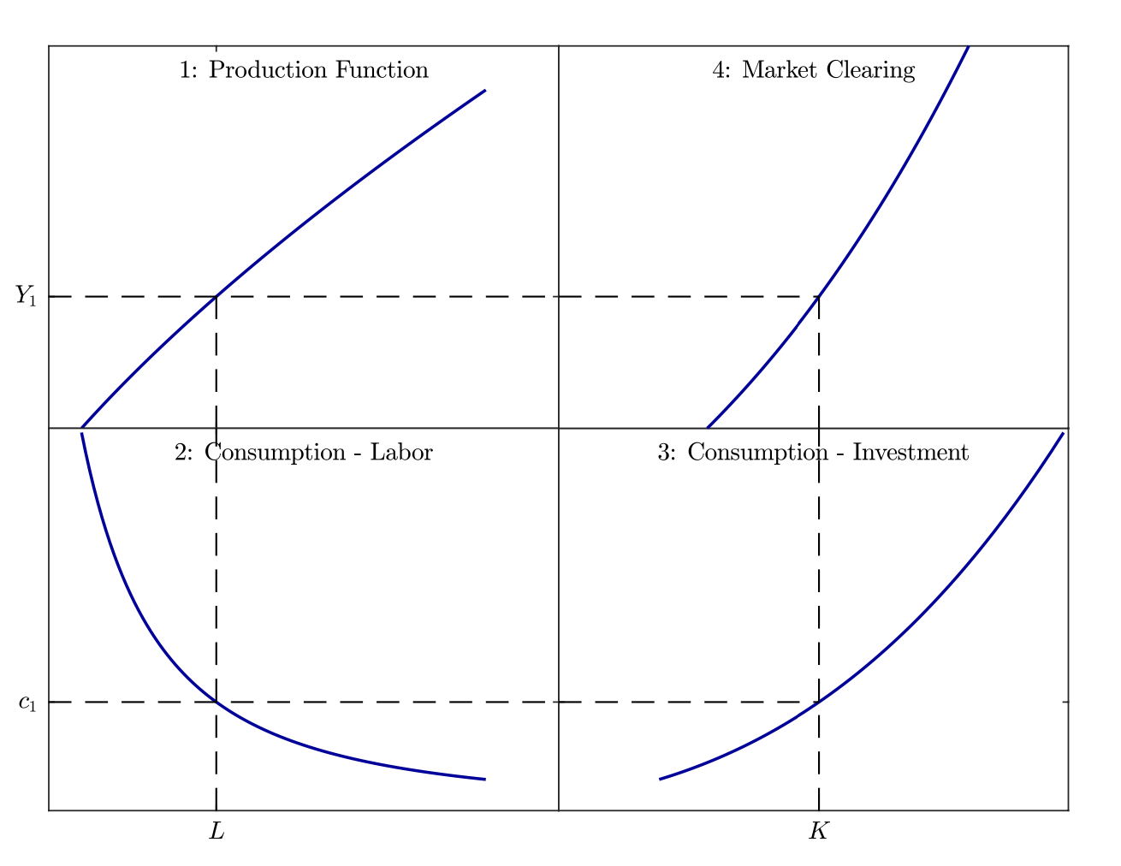
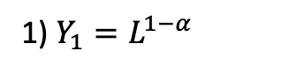
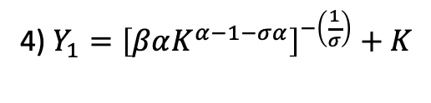
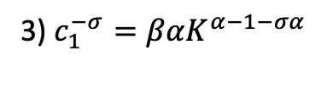
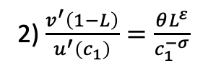
Two-Period Economy
1) $Y_{1}=L^{1−α}$
4) $Y_{1}={\left[βαK^{α−1−σα}\right]}^{−\left(\frac{1}{σ}\right)}+K$
2) $\frac{v^{′}\left(1−L\right)}{u^{′}\left(c_{1}\right)}=\frac{θL^{ε}}{c_{1}^{−σ}}$
3) $c_{1}^{−σ}=βαK^{α−1−σα}$

Slide 52
Two-Period Economy: Correct Estimate
Note: We can start in a different order.
As long as we are in equilibrium, we will end up with our initial estimate

Slide 53
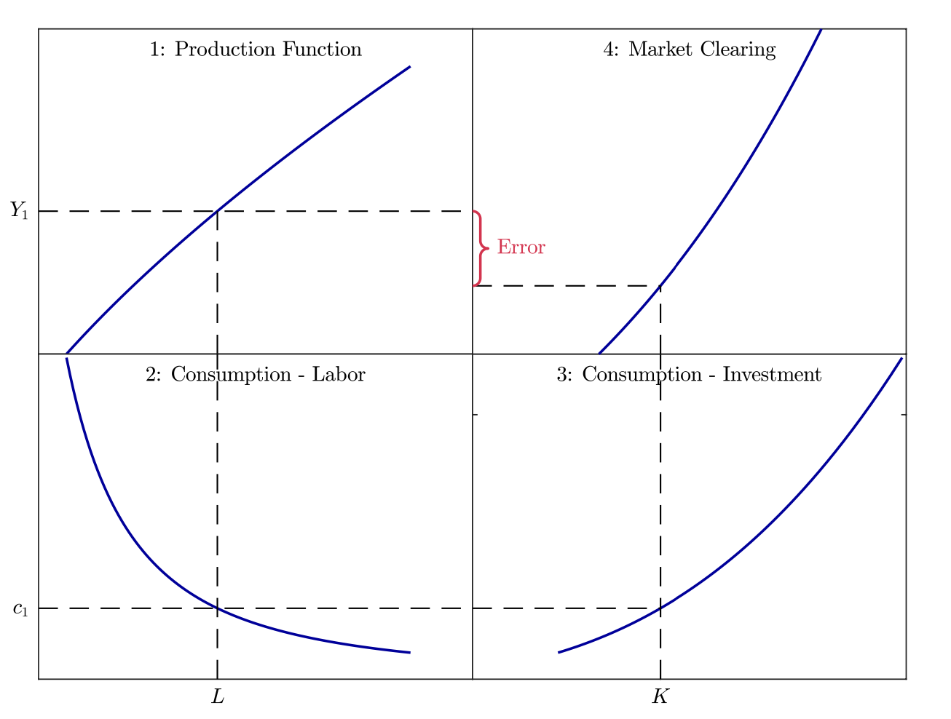
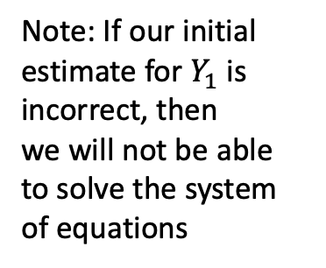
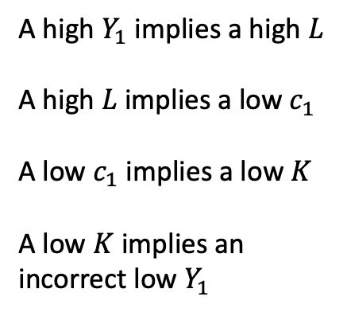
Two-Period Economy: Incorrect Estimate
Note: If our initial estimate for $Y_{1}$ is
incorrect, then we will not be able to solve the system of equations
A high $Y_{1}$ implies a high $L$
A high $L$implies a low $c_{1}$
A low $c_{1}$ implies a low $K$
A low $K$ implies an incorrect low $Y_{1}$

Slide 54
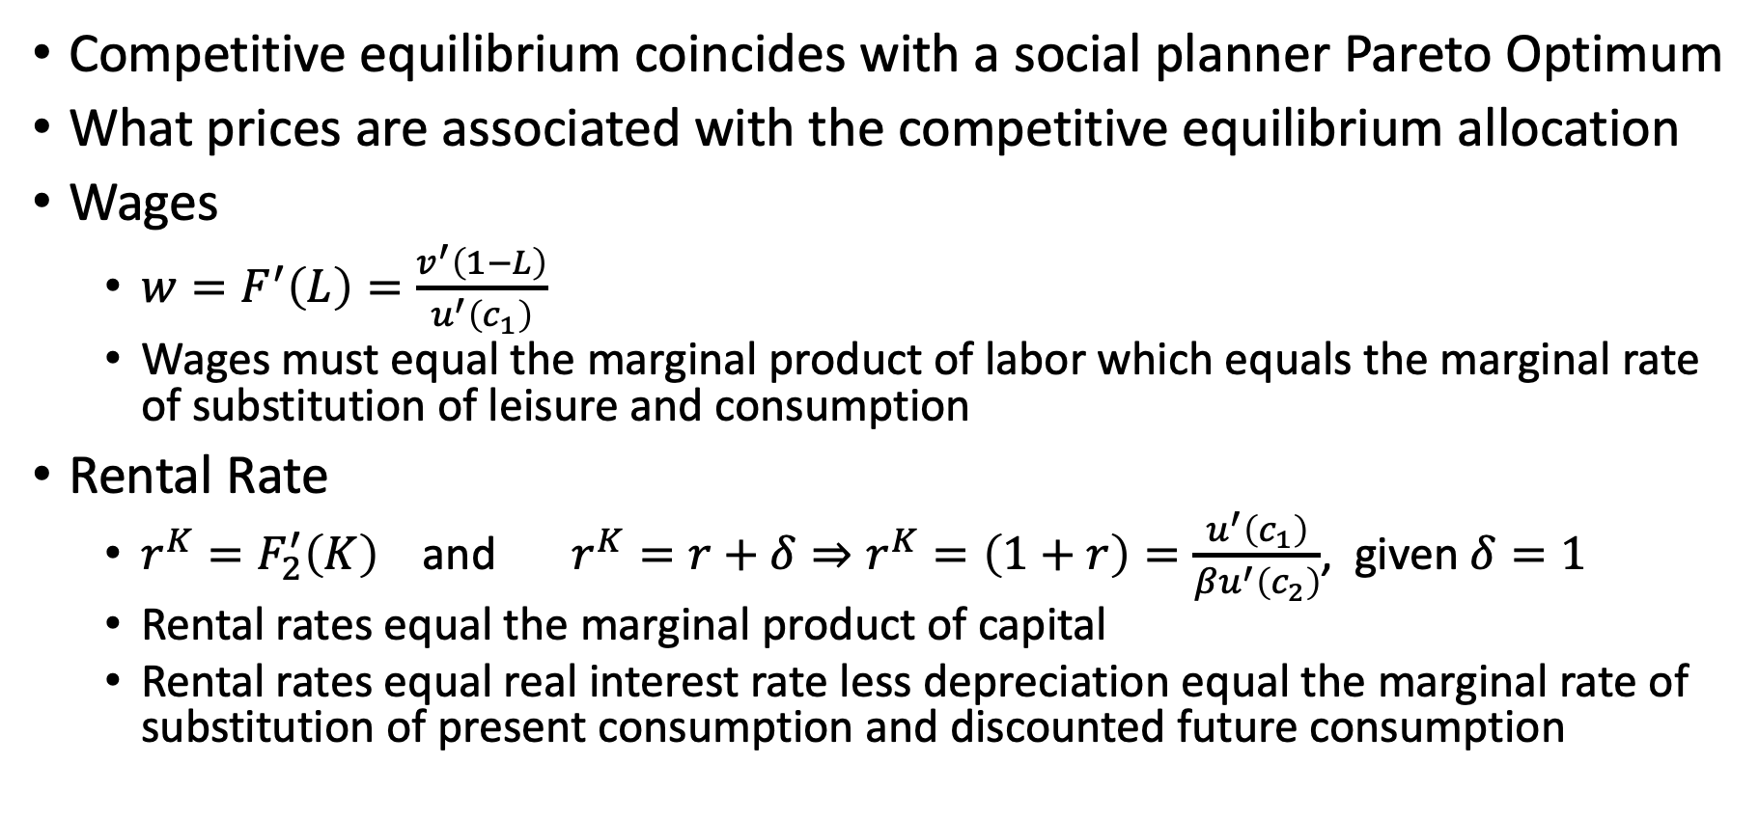
Markets
Competitive equilibrium coincides with a social planner Pareto Optimum
What prices are associated with the competitive equilibrium allocation
Wages
$w=F^{′}\left(L\right)=\frac{v^{′}\left(1−L\right)}{u^{′}\left(c_{1}\right)}$
Wages must equal the marginal product of labor which equals the marginal rate of substitution of leisure and consumption
Rental Rate
$r^{K}=F_{2}^{′}\left(K\right)$ and $r^{K}=r+δ⇒r^{K}=\left(1+r\right)=\frac{u^{′}\left(c_{1}\right)}{βu^{′}\left(c_{2}\right)}$, given $δ=1$
Rental rates equal the marginal product of capital
Rental rates equal real interest rate less depreciation equal the marginal rate of substitution of present consumption and discounted future consumption

Slide 55
Shocks

Slide 56
Productivity Shocks
What is a “Shock”
A shock is exogenous change in some aspects of the economy
Productivity Shock
We’ll first look at a productivity shock
This is an exogenous, unexpected change in the productive capacity of the economy
Productivity shocks are one of the main shocks as possible drivers of business cycle
We may have an increase in productivity driving growth
We may have a decrease in productivity driving contractions in output
It may be the ability to successfully or unsuccessfully deploy technologies
It may be regulations or problems at companies acting like negative shocks

Slide 57
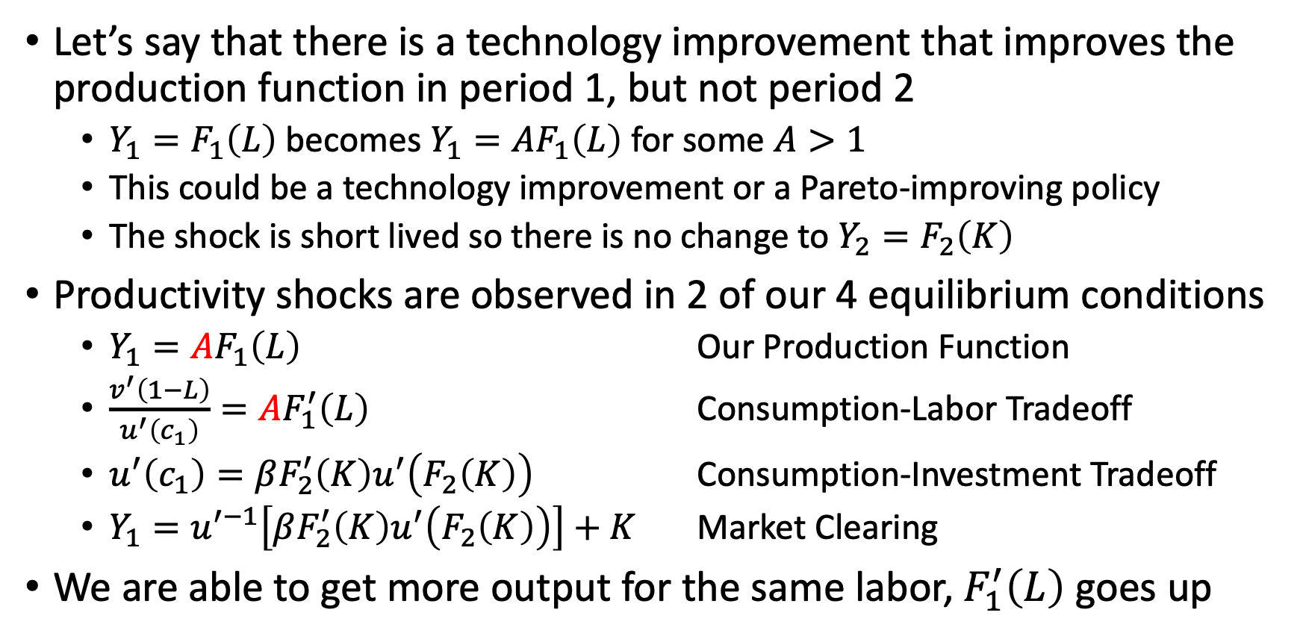
Productivity Shocks
Let’s say that there is a technology improvement that improves the production function in period 1, but not period 2
$Y_{1}=F_{1}\left(L\right)$ becomes $Y_{1}=AF_{1}\left(L\right)$ for some $A>1$
This could be a technology improvement or a Pareto-improving policy
The shock is short lived so there is no change to $Y_{2}=F_{2}\left(K\right)$
Productivity shocks are observed in 2 of our 4 equilibrium conditions
$Y_{1}=AF_{1}\left(L\right)$ Our Production Function
$\frac{v^{′}\left(1−L\right)}{u^{′}\left(c_{1}\right)}=AF_{1}^{′}\left(L\right)$ Consumption-Labor Tradeoff
$u^{′}\left(c_{1}\right)=βF_{2}^{′}\left(K\right)u^{′}\left(F_{2}\left(K\right)\right)$ Consumption-Investment Tradeoff
$Y_{1}=u^{′−1}\left[βF_{2}^{′}\left(K\right)u^{′}\left(F_{2}\left(K\right)\right)\right]+K$ Market Clearing
We are able to get more output for the same labor, $F_{1}^{′}\left(L\right)$ goes up

Slide 58



Productivity Shocks
Our Shifts:
First, $A$ increases our production function upwards for higher $F^{′}\left(L\right),$ $L$, and $Y_{1}$
Second, $A$ increases our consumption- labor tradeoff curve to the right.
This means the household should be willing to work more and consume more
Increases in $A$ do not shift our consumption-investment curve or
Output-investment curve
It does move the tradeoffs along these curves

Slide 59


Productivity Shocks
We’ll move from 1-4-3-2
First, direct effect of an increase in $A$ increases $Y_{1}$
Fourth, we have two opposing effects with labor-consumption with a right-ward shift: substitution and income effects. A higher $w=F_{1}^{′}(L)$ substitutes leisure for labor, $L$. But wealthier workers want more leisure. Here the substitution effect dominates.
Second, an increase in output from higher $F^{′}\left(L\right)$ increases $Y_{1}$ which implies increases investments, $K$
Third, higher $K$ from higher $F^{′}\left(L\right)$ and $Y_{1}$ implies higher consumption, $c_{1}$

Slide 60

Productivity Shocks
The economy has become temporarily more productive
Substitution effect dominates, so the representative household wants
1) Increase consumption
Productivity makes household feel wealthier
2) Increase investment
Households want to smooth out consumption between present and future
3) Work more
Time is temporarily more expensive, so households will work more to transform time into consumption goods (substitution effect)
4) Enjoy more leisure
Increases in $w=F^{′}\left(L\right)$ will make the households wealthier (income effect)

Slide 61
Productivity Shocks
The RBC model with productivity shock is one possible reason for economic expansion and contraction
With a positive or negative productivity shock
Productivity, GDP/output, consumption, employment, and investment will move in the same direction
With a temporary positive productivity shock
Economic expansion
Households will choose to work more from temporarily high wages
With a temporary negative productivity shock
Economic contraction
During a recession households will choose* to work less in response to temporarily low wages
We’ll revisit “choosing” to work less and temporarily low wages

Slide 62
Other Shocks
We’ll look at three other types of shocks
1) Impatience Shocks
2) Optimism Shocks
3) ”Laziness” or “Changes in preferences for leisure” Shocks
4) Tax Shocks

Slide 63

Impatience Shocks
We’ll look at an impatience shock to see if it is consistent with the macroeconomic data
Let say impatience exogenously increases or $β$ increases
This will shock will directly affect two equations
Consumption-investment tradeoff
$$u^{′}\left(c_{1}\right)=βF_{2}^{′}\left(K\right)u^{′}\left(F_{2}\left(K\right)\right)$$
We’ll consume more and invest less
Market clearing curve
$$Y_{1}=u^{′−1}\left[βF_{2}^{′}\left(K\right)u^{′}\left(F_{2}\left(K\right)\right)\right]+K$$
Shift $K$ lower and $Y_{1}$ lower

Slide 64

Impatience Shocks
Shifts
Consumption-investment tradeoff and shift the curve to the left
We’ll consume more and invest less
Market clearing curve shifts to the left
shift $K$ lower and $Y_{1}$ lower
Tradeoffs
For our consumption-leisure curve,
This will move the labor lower, but consumption higher
For our production function
Thi will move labor and output downward along the curve
Overall,
This is inconsistent with the macroeconomic data
We see that the model predicts consumption goes up while employment and output decrease, which is not supported by the data

Slide 65


Impatience Shocks
What is consistent with the data: Impatience shocks are consistent with declining $Y_{1}, K,$ and $L$
What isn’t consistent with the data: $c_{1}$ rises, when $Y_{1},K,$ and $L$ decline.
What makes this prediction poor is the labor-consumption tradeoff

Slide 66

Optimism Shocks
Let’s imagine that households become optimistic about the future
We imagine that we expect future productivity to rise so period 2 rises from some expected future technology
$Y_{2}=AF_{2}(K)$
Where $A>1$
We are focusing on behavior in period 1, so we are interested in expectations of future productivity regardless if it occurs
Optimism impacts
1)Consumption-Investment Tradeoffs
$c_{1}=βAF_{2}^{′}\left(K\right)u^{′}\left(AF_{2}\left(K\right)\right)$
2) Market Clearing:
$Y_{1}=u^{′−1}\left[βAF_{2}^{′}\left(K\right)u^{′}\left(AF_{2}\left(K\right)\right)\right]+K$

Slide 67



Optimism Shocks
$AF_{2}^{′}\left(K\right)$ and $AF_{2}\left(K\right)$ shifts output rightward.
However, our consumption-investment tradeoff has two opposing effects.
1) Higher MPK makes investing more attractive. 2) But higher MPK means period 2 consumption is higher, which lower marginal utility of consumption in period 2 through consumption smoothing.
What is consistent with the data:
$Y_{1}, K$, and $L$ increase.
What isn’t consistent with the data:
$c_{1}$, falls when $Y_{1}, K,$and $L$ rise.
Again, the consumption-labor tradeoff sinks this model’s prediction, and consumption moves the opposite direction

Slide 68

Laziness or Tax Shocks
We can model the preferences for disutility of work with $θ$
When $θ=1$, we have $u\left(c_{1}\right)+θv\left(l\right)+βu\left(c_{2}\right)=u\left(c_{1}\right)+v\left(l\right)+βu\left(c_{2}\right)$
So $θ>1$ to model an increase in disutility of work
$θ$ comes from our consumption-labor tradeoff
$$\frac{θv^{′}\left(1−L\right)}{u^{′}\left(c_{1}\right)}=F_{1}^{′}\left(L\right)$$
An increase in $θ>1$, will shift the curve to the left, which decreases consumption, $c_{1}$, and employment, $L$
The net effect is that households work less, which lowers output from $Y=F_{1}\left(L\right)$
A fall in output is a fall in consumption and investment consistent with the consumption-investment tradeoff
This type of shock is consistent with a recession
Employment, investment, consumption, and output all fall
But, do recessions happen when everyone decides to rest more?

Slide 69

Laziness or Tax Shocks
We have a similar recessionary estimate with taxes, which functions similarly to an increase in $θ$
A representative firm still equates $F_{1}^{′}\left(L\right)=w$, but our consumption-labor trade off becomes
$$\frac{v^{′}\left(1−L\right)}{u^{′}\left(c_{1}\right)}=w\left(1−τ_{I}\right)=F_{1}^{′}\left(L\right)\left(1−τ_{I}\right)$$
$$⇒\frac{\frac{1}{1−τ_{I}}v^{′}\left(1−L\right)}{u^{′}\left(c_{1}\right)}=F_{1}^{′}\left(L\right)$$
This is similar to theta, where $(1−τ_{I})$ shifts the curve to the left
The net effect is that households work less, which lowers output from $Y=F_{1}\left(L\right)$
A fall in output is a fall in consumption and investment consistent with the consumption-investment tradeoff
This type of shock is consistent with a recession
Employment, investment, consumption, and output all fall
But, how often do tax rates change and changes don’t correlate with business cycles well

Slide 70


Laziness or Tax Shocks
What is consistent with the data: Increases in disutility of work or taxes reduces output, $Y_{1}$, investment, $K$, consumption, $c_{1}$ and employment, $L$
These factors impact our consumption-labor curve, which shifts leftward

Slide 71
Assessing the Real Business Cycle Model

Slide 72
Assessing the Real Business Cycle Model
Is the Real Business Cycle Model a good theory for business cycles?
We want to try to answer this question
First, why some kinds of shocks produce business cycles while other type of shocks do not in the Real Business Model?
We saw that productivity, tax, and disutility of working shocks produce business-cycle responses
The Real Business Cycle Model has a common source to produce something like a business cycle: the labor-consumption tradeoff
Anything that does not shift the labor-consumption tradeoff curve will cause a tradeoff between consumption and employment
Two effects for the representative household when it does not shift
1) Households feel richer and consume more and work less
2) Households feel poorer and consumes less and work more

Slide 73

Assessing the Real Business Cycle Model
Why did productivity, taxes, and disutility/laziness produce business cycles in the model?
These shocks directly impact the labor-consumption tradeoff curve
These shocks affect how the household perceive the tradeoff between time dedicated to working and time dedicated to leisure
The other types of shocks did not directly affect the labor-consumption tradeoff curve
Assumption
The labor market is competitive
Households can choose without restriction about how much labor they provide each period at the market wage $w$
The model thinks about employment and structural unemployment (or involuntary unemployment) does not exist since the market is competitive
What happens when the labor market is not competitive?

Slide 74

Assessing the Real Business Cycle Model
Is the Real Business Cycle Model a good theory for business cycles?
We can try to do a quantitative assessment
Do the following steps
Construct a full model with infinite horizon instead of a 2-period model that include labor, capital, and depreciation in every period
Set values for your parameters, such as $α, β, ε,θ$, etc. based on microeconomic data
Do a growth-accounting exercise and find the Solow residuals for each period (which is usually quarters). How large are the productivity changes?
Simulate how the model economy would respond to technology shocks from the growth accounting Solow residual changes in the prior step
Measure the behavior of the variables of interest in the model economy such as GDP, employment, and investment, and compare it to the same measures taken from the real economy.

Slide 75
Assessing the Real Business Cycle Model
How does the Real Business Cycle Model do when going through these 5 steps?
We need to compare predicted vs actual
Kydland and Prescott (1982) found that the Real Business Cycle Model could produce about two-thirds (66%) of the volatility in GDP observed in real data
In addition, the Real Business Cycle Model reproduce the main correlations that define a business cycle:
Productivity, output, employment, consumption, and investment move together
Investment is more volatile than GDP
Kyland and Prescott (1982) conclude that while the model is not perfect, it is satisfactory approximation of real economy behavior

Slide 76
What are the policy implications?
Key: It is assumed that the First Welfare Theorem holds in the Real Business Cycle Mode
If this model is correct, then fiscal and monetary policy can be harmful
When first proposed, it ran counter to decades of macroeconomic thinking
What does this mean?
Key: Business cycles are just the efficient way for the economy to respond to changes in productivity
There is no reason to improve what the market is doing and nothing should be done to stabilize or prevent business cycles
When productivity rises, people should work more and produce more
When productivity falls, people should enjoy more leisure
This looks at real (not nominal) business cycles
No need for monetary policy to stabilize the economy

Slide 77

What are the criticisms?
The mechanisms for generating recessions are not very plausible
If we take productivity shocks literally as the result of technological progress, is it plausible for the rate of technology progress to fluctuate so much?
Defenders say that productivity shocks should be interpreted less literally and may represent changes in regulation or specific problems in large firms
Disagreement with the parameters needed to describe the household’s willingness to substitute between consumption and leisure – Frisch elasticity $ε$
Frisch elasticity captures the substitution effect with a change in wages
To produce large fluctuations in employment, the elasticity of labor supply needs to be high
The elasticity used in the Real Business Cycle Model is contradictory to microeconomic data from household behavior
Usual ranges are between 0.27 to 0.53 (Whalen & Reichling, 2017)

Slide 78
What are the criticisms?
It does not fit the behavior of prices
It does a better job with predicting the behavior of quantities
Real wage do not co-vary with business cycles
No structural (involuntary) unemployment
Structural unemployment is a main feature of business cycles
There is no structural unemployment in the Real Business Cycle Model
Treating the Solow residual as an exogenous productivity
For example, a restaurant sees a slow down in business and its factor of production are not being utilized
The restaurant having lower productivity due to business condition
This is an endogenous (circular) cycle and not due to the restaurant having lower technology employed

